Slide 1

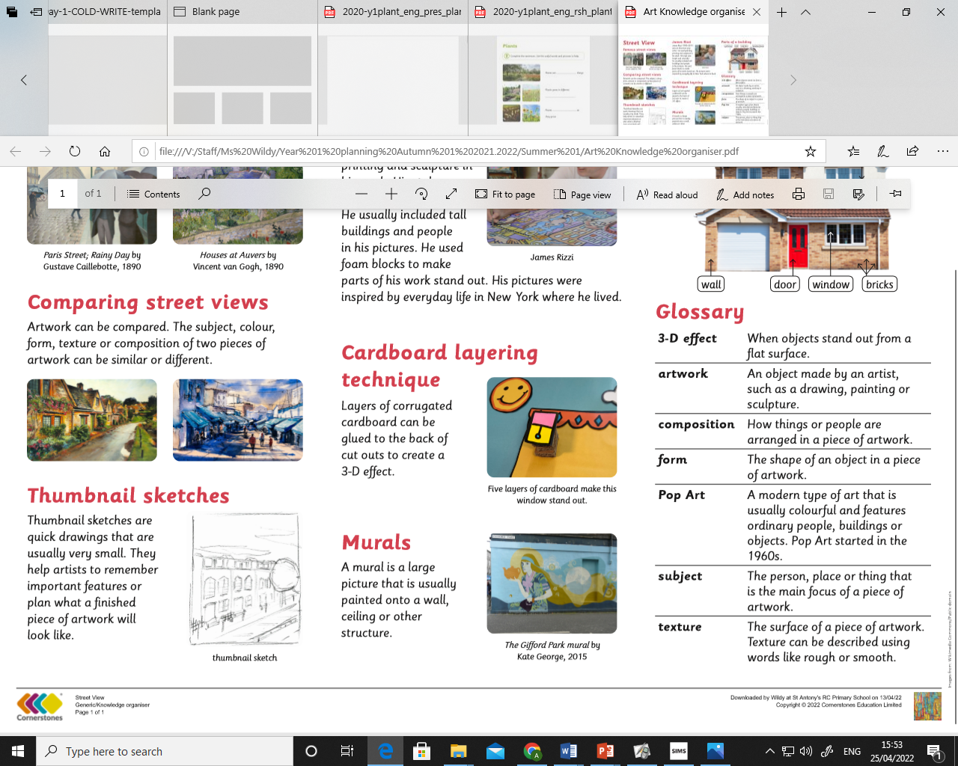
My Know And Remember More card about ...... School Days 3-D Art and Drawing.
Key facts to remember
1. Thumbnail sketches are quick drawings that are usually very small. They help artists to remember important features or plan what a finished piece of artwork will look like.
2.James Rizzi (1950-2011) was an American pop artists. He painted buildings and used blocks to make his work stand out.
3. Layers of corrugated cardboard can be glued to the back of cut outs to create a 3-D effect. This is a layering technique.
4. A mural is a large picture that is usually painted onto a wall, ceiling or other structure.
5. To name parts of a building guttering, roof, roof tiles, window frame, wall, door, window and bricks.
Vocabulary
Pop Art | A modern type of art that is colourful and features people, buildings or objects.
Form | The shape of an object in a piece of artwork.
Texture | The surface of a piece of artwork. Texture can be described using the words rough or smooth.
3-D effect | When objects stand out from a flat surface.
Composition | How things or people are arranged in a piece of artwork.
My memory jogger
Diagram of…
This links to… | Previous Learning
Science and investigating materials. History and famous artists in history. | Printing and exploring texture.

