Slide 1

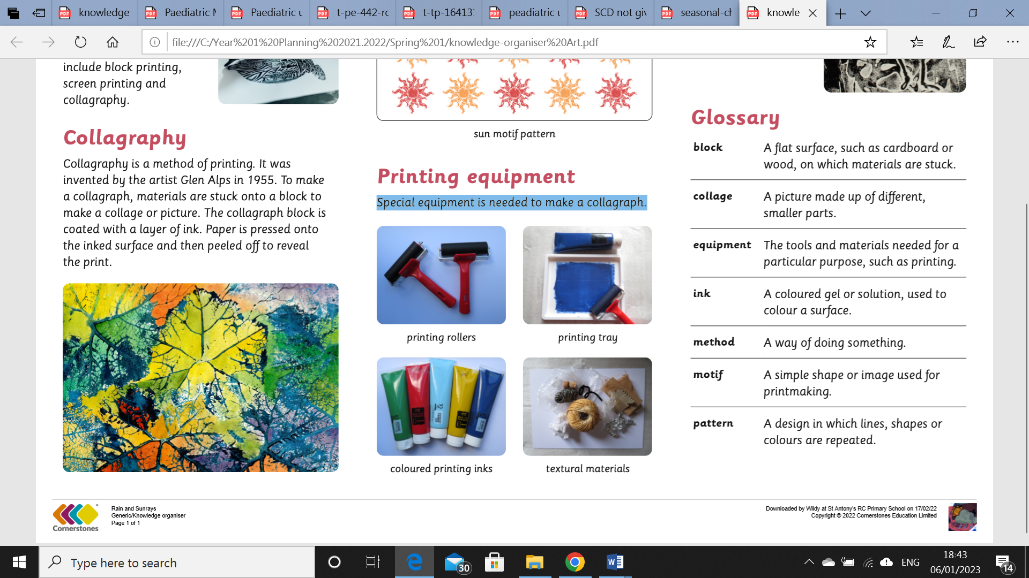
My Know And Remember More card about Printing and Collage
Key facts to remember
1. Collagraphy is a method of printing. It was invented by the artist Glen Alps in 1955. To make a collagraph, materials are stuck onto a block to make a collage or picture. The collagraph block is coated with a layer of ink. Paper is pressed onto the inked surface and then peeled off to reveal the print.
2. A print is a picture made by transferring an image from one surface to another. Different types of printmaking include block printing, screen printing and collagraphy.
3. A printing motif is an image made with simple lines and shapes. A motif can be used once in a design, or repeated to make a pattern.
4. Special equipment is needed to make a collagraph.
5. That a collage is a picture made up of different, smaller parts.
Vocabulary
Block | A flat surface, such as cardboard or wood, on which materials are stuck.
Ink | A coloured gel or solution, used to colour a surface.
Pattern | A design in which lines, shapes or colours are repeated.
Equipment | The tools and materials needed for a particular purpose, such as printing.
Method | A way of doing something
My memory jogger
Primary colours are red, yellow and blue. Primary colours are used to make secondary colours.
Composition is how the picture is arranged.
Diagram of a Collagraph & printing equipment
This links to… | Previous Learning
The environment and materials and using natural resources to make prints/ | Colour mixing and knowing the primary and secondary colours.

