Slide 1

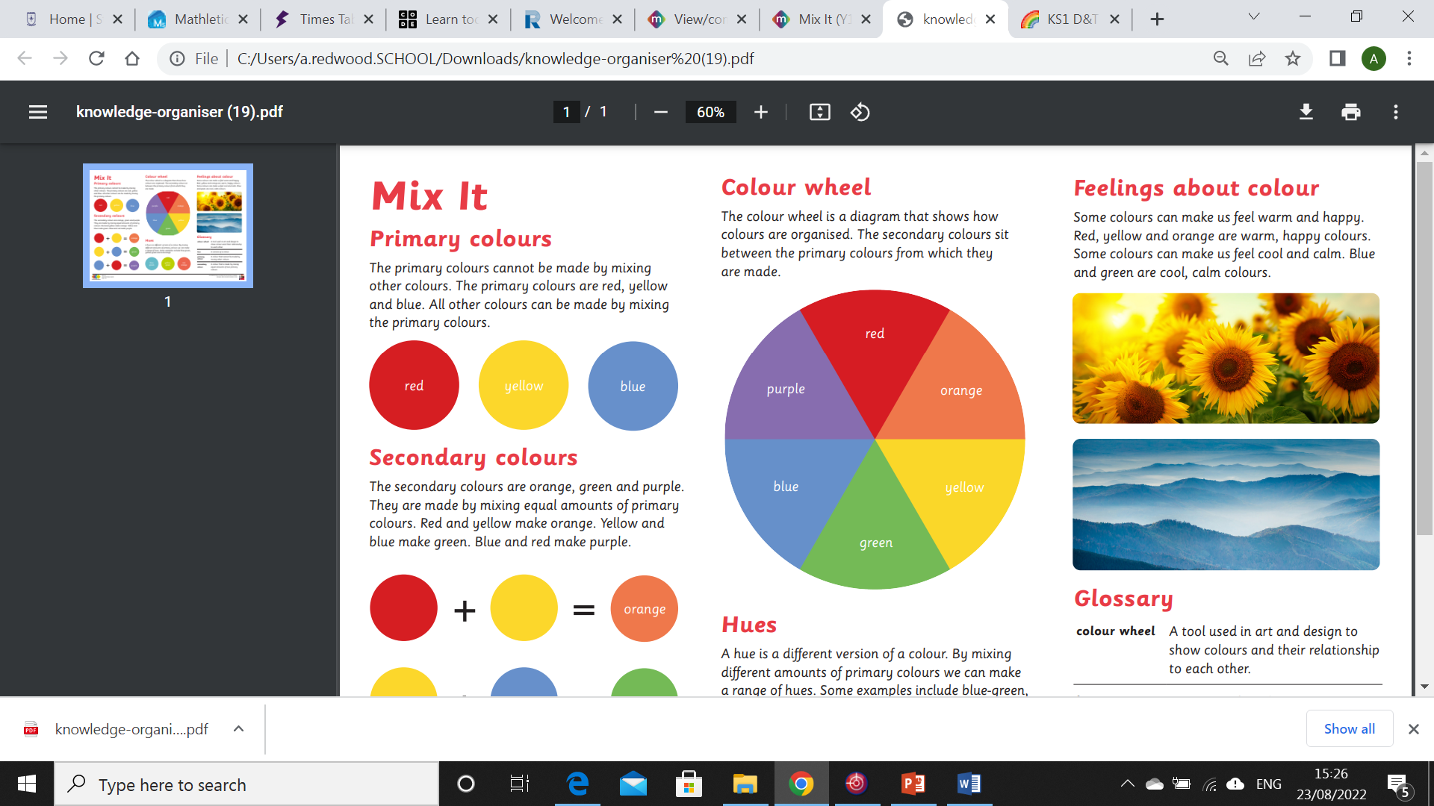
My Know And Remember More card about .......Art Mix It
Key facts to remember
1. The primary colours cannot be made by mixing other colours. The primary colours are red, yellow and blue. All other colours can be made by mixing the primary colours.
2. The secondary colours are orange, green and purple. They are made by mixing equal amounts of primary colours. Red and yellow make orange. Yellow and blue make green. Blue and red make purple.
3. A hue is a different version of a colour. By mixing different amounts of primary colours we can make a range of hues. Some examples include blue-green, yellow-green and red-orange
4. The colour wheel is a diagram that shows how colours are organised. The secondary colours sit between the primary colours from which they are made
5. Some colours can make us feel warm and happy. Red, yellow and orange are warm, happy colours. Some colours can make us feel cool and calm. Blue and green are cool, calm colours.
Vocabulary
Composition | How things or people are arranged in a piece of artwork
Artwork | An object made by an artist, such as a drawing, painting or sculpture.
Secondary | A colour that is made by mixing equal amounts of two primary colours
Primary | A colour that cannot be made by mixing other colours
Print | a picture or design printed from a block or plate or copied from a painting by photography.
My memory jogger
Diagram of…A Colour Wheel
This links to… | Previous Learning
PSHE and using painting, colouring and drawing as a relaxation technique. | Experimenting with different media and learning colour names.

