Slide 1

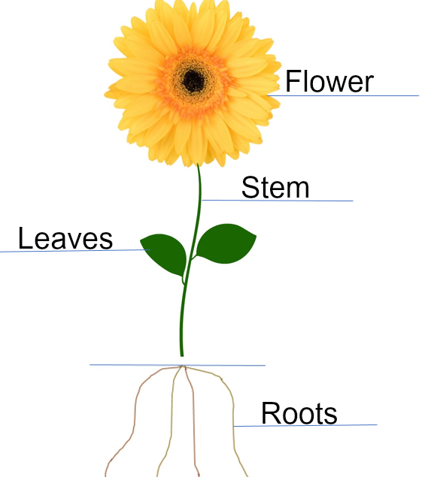
My Know And Remember More card about Art and Design – Colour, Texture, Pattern
Key facts to remember
1. Flowers are a natural form. They can be brightly coloured, patterned and various shapes and sizes. Flowers are brightly coloured to attract insects.
2. Contemporary artists are living at this time. Many contemporary artists are inspired by flowers. Yayoi Kusama is a Japanese contemporary artists.
3. Flowers often have beautiful and delicate patterns. Adding pattern to drawings adds interest and detail.
4. Flowers have interesting textures. Texture is added to artwork using textural materials or by making marks on the surface of the artwork.
5. Flowers and petals have interesting shapes. When drawing, lines are used to create the outline of the flower or its smaller parts.
6. Van Gogh, Yayoi Kusama, Dale Chihuly are all artists inspired by flowers.
Vocabulary
Colour | The hue or shade of something.
Form | The 3-D shape of something.
Line | A mark made in drawing.
Pattern | A decorative design.
Sculpture | A 3-D form.
Shape | The outline of something.
Visual element | A characteristic that can be seen, such as line, shape, form, colour, pattern and texture.
My memory jogger
Van Gogh – Dutch Painter
Yayoi Kusama – Japanese contemporary artist Dale Chihuly - American glass artist
Diagram of…Parts of a flower
This links to… | What’s next?
Plants in Science Spring 2 | Still life and flowers

