Slide 1

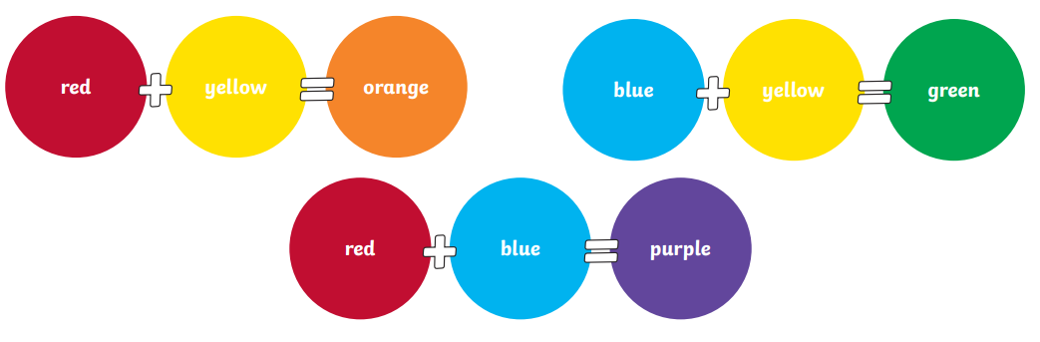
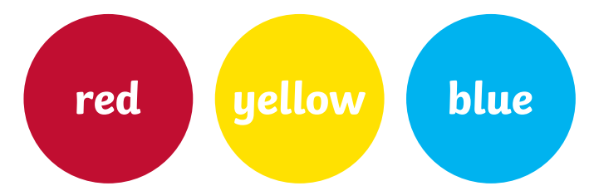

My Know And Remember More card about Art and Design - Colour
Key facts to remember
1. The primary colours are red, yellow and blue. All other colours can be made by mixing the primary colours.
2. The secondary colours are orange, green and purple. They are made by mixing equal amounts of primary colours.
3. The colour wheel is a diagram that shows how colours are organised. The secondary colours sit between the primary colours from which they are made.
4. Colours make different effects when placed next to each other and can express different moods and emotions.
5. Wassily Kandinsky was born on 16 December 1866 in Moscow, Russia. He loved art, colour and music.
Vocabulary
Primary Colour | A colour that cannot be made by mixing other colours.
Secondary Colour | A colour that is made by mixing equal amounts of two primary colours.
Colour Wheel | A tool used in art and design to show colours and their relationship to each other.
Hue | A version of a colour.
Wassily Kandinsky | A famous Russian artist.
Piet Mondrian | A famous Dutch artist.
My memory jogger
Primary Colours and Secondary Colours
The Colour Wheel
Diagram of…Making Secondary Colours
This links to… | What’s next?
History and famous artists in history. | Still life drawing and painting. Artists - Paul Cezanne and Vincent Van Gogh

