Slide 1



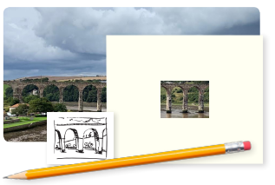
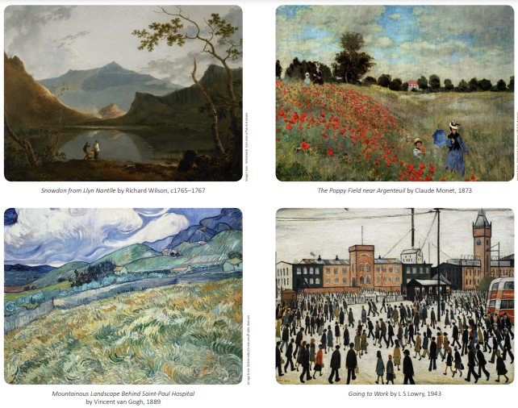
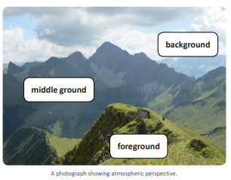
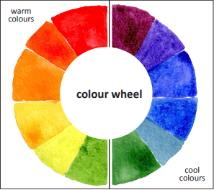
My Know And Remember More card about Vista.
Key facts to remember
Landscape is a genre of art that became popular during the eighteenth century.
The choice of colour that an artist makes can create a feeling of warmth or coolness in a painting.
Shading techniques such as cross-hatching, hatching, stippling and random lines can be used to add different tones to a landscape.
A viewfinder is a frame that isolates a small part of a landscape.
Atmospheric perspective is a technique that creates depth in a landscape.
Vocabulary
Cross-hatching | A drawing technique that uses groups of parallel lines, which usually overlap at a 90° angle, to add shade, tone and texture to a drawing
hatching | A drawing technique that uses a series of parallel lines to add shade, tone and texture to a drawing
stippling | A drawing technique that uses dots to create areas of light and shade.
technique | An activity that requires skill to complete
scene | A view or picture of a place, activity or event.
This links to… | What’s next?
Geography – Misty Mountain Winding River
My memory jogger
Diagram of… Landscapes and atmospheric perspective.

