Slide 1

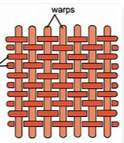
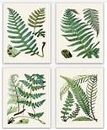
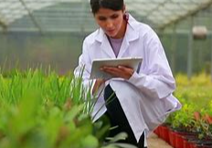
My Know And Remember More card about Art : Beautiful Botanicals
Key facts to remember
1. Botanical art often uses natural materials.
2. Weaving techniques show two directions: warp and weft.
3.Initial sketches are used to build ideas.
4. Botanical art can be modern or from the past.
5.A range of materials can used including printing, charcoal or painting.
Vocabulary
Botanical | Related to the study of plants.
Warp/weft | Weaving that turns yarn into thread.
Preliminary | Sketches that start you off.
Print | Where a shape makes a mark on a surface.
Exhibition | Where a variety of work is displayed.
My memory jogger
Botany is the study of the classification and importance of plants.
Example of Botanical Art
This links to… | Previous Learning
Science – classifying fruit. Mathematics; Repeating patterns and symmetry. | Sketches are used to inspire final pieces . Fruit is often used to inspire Botanical Art.

