Slide 1

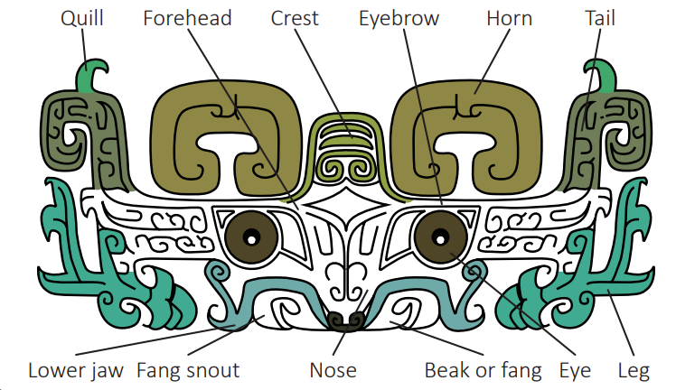
My Know And Remember More card about Dynamic Dynasties – Taotie – Art
Key facts to remember
1. A taotie is a creature in Chinese mythology. Its name translates to ‘legendary voracious beast’ because of its huge appetite.
2. Bronze vessels were made using piece-mould casting. This was a complex process not used anywhere else in the world at that time.
3. A cast is an object made by shaping a material, such as metal or plaster, in a mould.
4. A mould is a hollow container used to give shape to another material, such as metal or plaster.
5. Casting is a process in which a liquid material is usually poured into a mould, which contains a hollow cavity of the desired shape.
Vocabulary
Bronze | a yellowish-brown alloy of copper with up to one-third tin.
Cast | an object made by shaping molten metal or similar material in a mould.
Mould | a hollow container used to give shape to molten or hot liquid material when it cools and hardens.
Molten | liquefied by heat.
Taotie | The Taotie is an ancient Chinese mythological creature that was commonly emblazoned on bronze and other artifacts during the 1st millennium BC.
My memory jogger
Diagram of…
This links to… | What’s next?
Design Technology – using materials. Science – properties of materials. | Y6 Art

