Slide 1

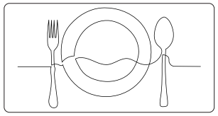
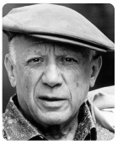
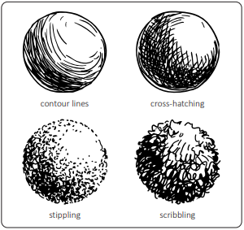
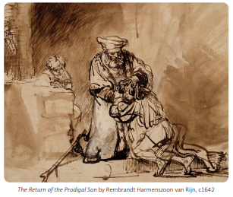
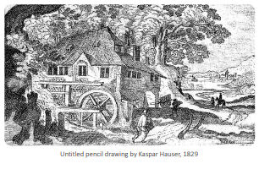
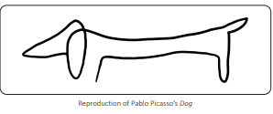
My Know And Remember More card about Line, Light and Shadows.
Key facts to remember
Continuous line drawings are made by keeping a pen or pencil in contact with the paper for the duration of the drawing.
These drawings help artists to develop their observational skills because they have to look carefully at what is in front of them.
Pablo Picasso was a Spanish painter who lived from 1881 to 1973. He used many artistic styles, including the continuous line technique. He would take a complex subject and simplify it into one unbroken line.
Shading is a technique that artists use to give the illusion of a 3-D form on a 2-D surface.
Rembrandt Harmenszoon van Rijn, simply known as Rembrandt, was a Dutch painter who lived in the 17th century. He had a love of line drawings.
Vocabulary
abstract | Abstract art consists of shapes and patterns rather than realistic representations of objects.
composition | How the subjects of a picture are arranged.
contrast | The degree of difference between the lighter and darker parts of an image.
form | The three-dimensional aspect of a picture
Shade | Shadows in a picture.
My memory jogger
Continuous line drawing
Shading effects
Diagram of… Line, Light and Shadows
Pablo Rembrandt Picasso
This links to… | What’s next?
Geography – Sow, Grow and Farm.

