Slide 1
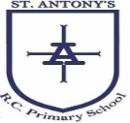

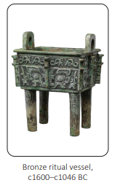
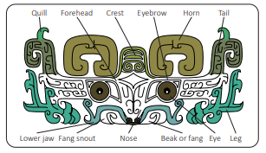
My Know And Remember More card about Taotie.
Key facts to remember
A taotie is a gluttonous creature in Chinese mythology, which is always hungry no matter how much it eats
During the Shang Dynasty, craftspeople used a complex technique called piece-mould casting to make highly-decorated bronze vessels and objects.
The taotie’s face has large eyes and styled fangs, horns and eyebrows. Cleverly, each side of this taotie design also represents a one-legged beast called a gui dragon
Both dragons are facing each other and have a large eye and curled tail. The tail is made of a square spiral shape called a thunder and cloud pattern.
Images of taotie appear on ancient Chinese bronze artefacts, such as masks and ritual vessels called dings.
Vocabulary
bronze | A yellow-brown metal alloy of copper and tin.
cast | An object formed by putting a molten or soft material in or on a mould.
mould | A typically hollow container, used to give shape to a molten or soft material when it cools and hardens.
molten | A substance made liquid by heat.
gluttonous | Excessively greedy.
My memory jogger
Silicone casting Clay casting
Paper casting
Diagram of… Taotie
This links to… | What’s next?
History – Dynamic Dynasties

