Slide 1

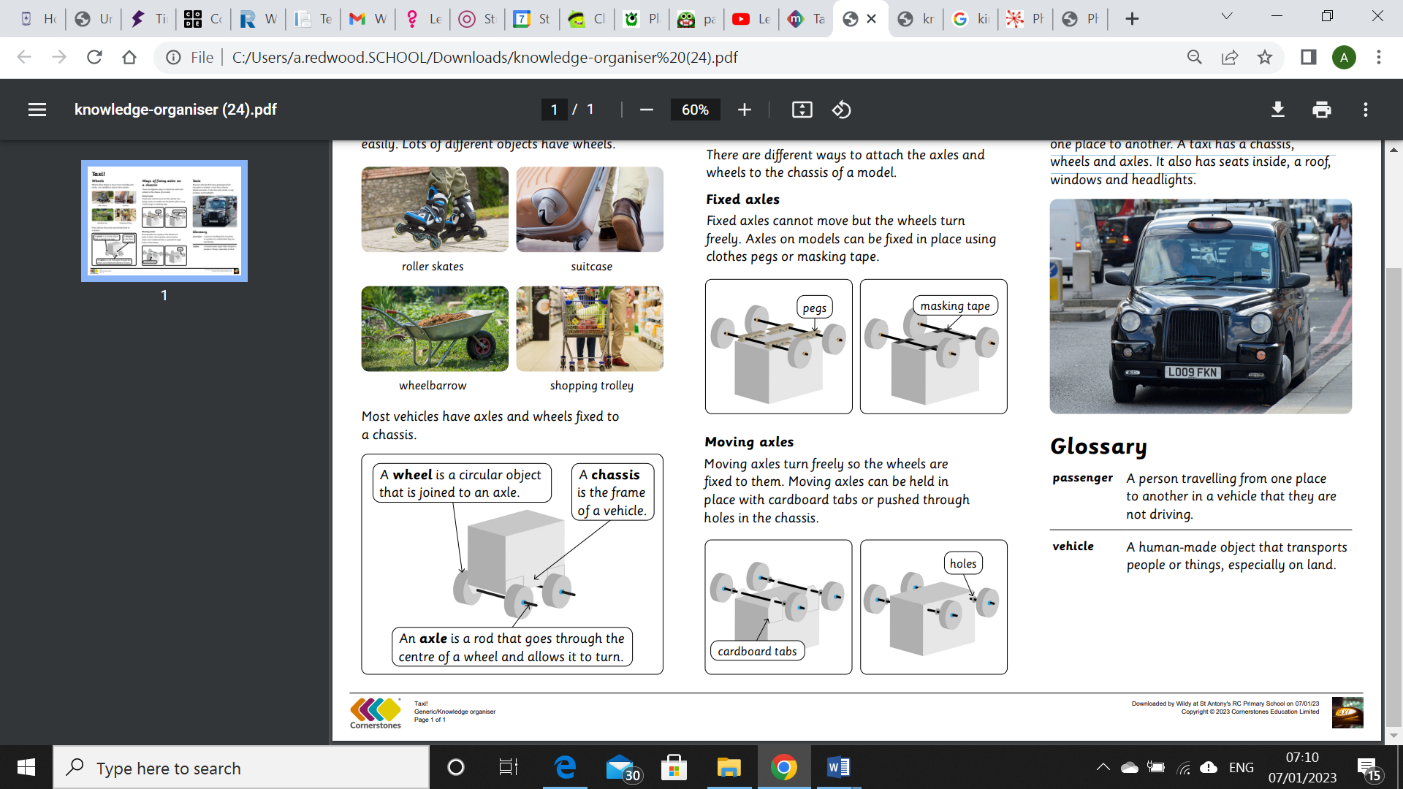
My Know And Remember More card about Axles/TAXI!!
Key facts to remember
1. Fixed axles cannot move but the wheels turn freely. Axles on models can be fixed in place using clothes pegs or masking tape.
2. Moving axles turn freely so the wheels are fixed to them. Moving axles can be held in place with cardboard tabs or pushed through holes in the chassis
3. Taxis are vehicles that carry passengers from one place to another. A taxi has a chassis, wheels and axles. It also has seats inside, a roof, windows and headlights.
4. A vehicle is a human-made object that transports people or things, especially on land.
5. A chassis is the frame of a vehicle.
Vocabulary
Fixed Axle | Fixed axles cannot move but the wheels turn freely. Axles on models can be fixed in place using clothes pegs or masking tape.
Moving Axle | Moving axles turn freely so the wheels are fixed to them. Moving axles can be held in place with cardboard tabs or pushed through holes in the chassis.
Vehicle | A human-made object that transports people or things, especially on land.
Passenger | A person travelling from one place to another in a vehicle that they are not driving.
Taxi | Taxis are vehicles that carry passengers from one place to another. A taxi has a chassis, wheels and axles. It also has seats inside, a roof, windows and headlights.
My memory jogger
Diagram of…a vehicle
This links to… | Previous Learning
Geography and learning about London and different transport. Science-investigating materials. | Making and designing shelters and investigating materials.

