Slide 1

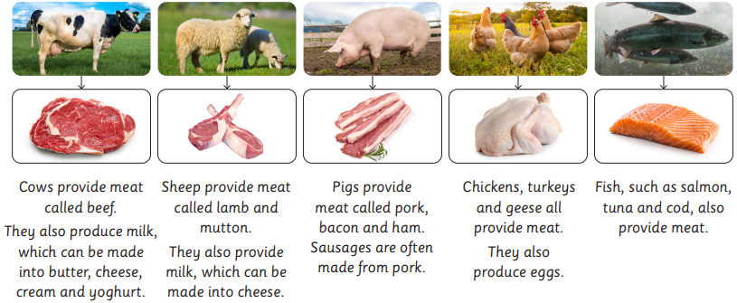
My Know And Remember More card about Design Technology – Remarkable Recipes
Key facts to remember
All food has to be farmed, grown or caught.
Food comes from two main sources, animals and plants.
Some foods need to be cooked or prepared before they are eaten. Some foods can be eaten raw.
A healthy diet contains a variety of food sources from the different food groups.
A recipe is a series of instructions to be followed for cooking or preparing a dish.
Vocabulary
Edible | Suitable or safe to eat
Equipment | The set of tools needed for a particular purpose
Ingredients | The foods that are necessary to prepare a dish.
Vegan | Only eat foods from plants
Hygiene | Maintaining health and preventing disease, through cleanliness
Vegetarian | Eats foods from plant sources and animal products but not meat
My memory jogger
We cook food so that it:
Tastes better Is safer to eat Is easier to digest Lasts longer Is softer and more edible
This links to… | What’s next?
Instructional writing in English. World Faith Week and foods from other cultures | Push and pull – pop up card

