Slide 1



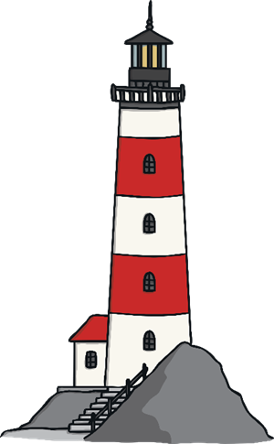
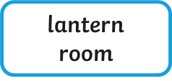


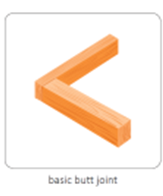
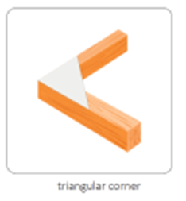


My Know And Remember More card about Design Technology - Lighthouses
Key facts to remember
1. Lighthouses are a human feature found on coastlines. They keep sailors and boats safe by warning them that the rocks are near.
2. Structures can be made stronger, stiffer and more stable by using cardboard rather than paper and triangular shapes rather than squares. A broader base will also make a structure more stable.
3. A design criteria tells us the things we need to include in our design for it to be successful, it helps us to evaluate our product to improve it in the future.
4. In 1838, Grace Darling rowed out to sea to save 9 sailors who were shipwrecked.
5. Different types of joints, like a butt joint and a triangular joint, will make our structure stronger.
Vocabulary
Human Feature | Made or built by humans
Lighthouse | A tower that has a light or beacon to warn ships at sea of danger.
Butt joint | Two pieces of material are joined by placing their ends together without any special shaping.
Triangular corner | Two pieces of material are joined together at right angles with a triangle piece to strengthen them.
Lighthouse
My memory jogger
Butt Joint Triangular Corner
This links to… | What’s next?
Geography and human features. History and historically significant people. Art and colour. | Creating recipes to a design criteria. Evaluating our products.

Slide 2
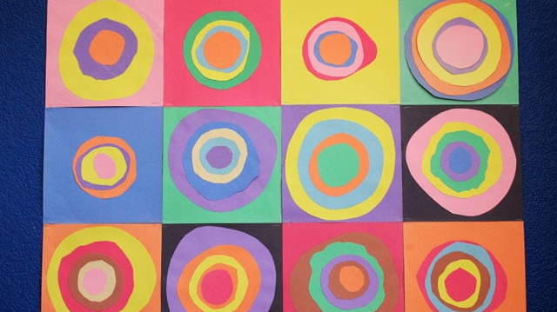
WASSILY KANDINSKY
WASSILY KANDINSKY
WASSILY KANDINSKY
WASSILY KANDINSKY
WASSILY KANDINSKY
WASSILY KANDINSKY
WASSILY KANDINSKY
WASSILY KANDINSKY
WASSILY KANDINSKY
WASSILY KANDINSKY
WASSILY KANDINSKY
WASSILY KANDINSKY

