Slide 1
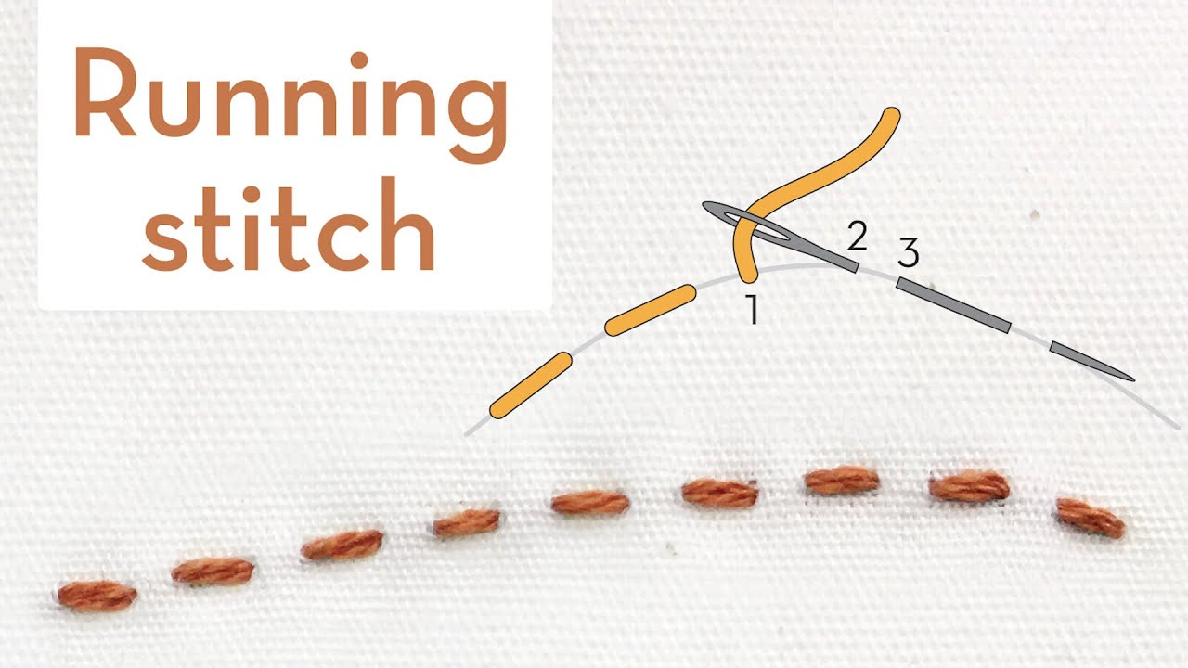

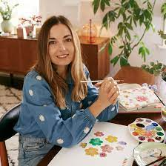
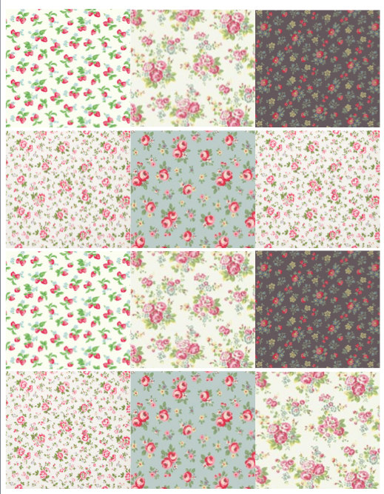
My Know And Remember More card about Design Technology – Cut, Stitch, Join
Key facts to remember
Many home products are made from fabric, including tea towels, pillowcases, cushions, tablecloths and peg bags.
Cath Kidston is a British textile and homeware designer. She founded the Cath Kidston brand.
A sewing pattern is a template of the parts needed to make a product.
Fabric products can be improved by making them easier to use, more hardwearing or more attractive.
A running stitch is a basic stitch used to join fabric.
Vocabulary
Textile | A fabric made by hand or machine
Embellishment | Embellishments including sequins, appliqué, buttons and printing can be used to decorate fabric.
Motif | An image or design that can be repeated to create a pattern.
Needle | a very fine piece of polished metal with a point at one end and a hole or eye for thread at the other, used in sewing.
Thread | A long, thin strand of cotton, nylon, or other fibres used in sewing or weaving.
Fabric | cloth or other material produced by weaving or knitting fibres.

