Slide 1

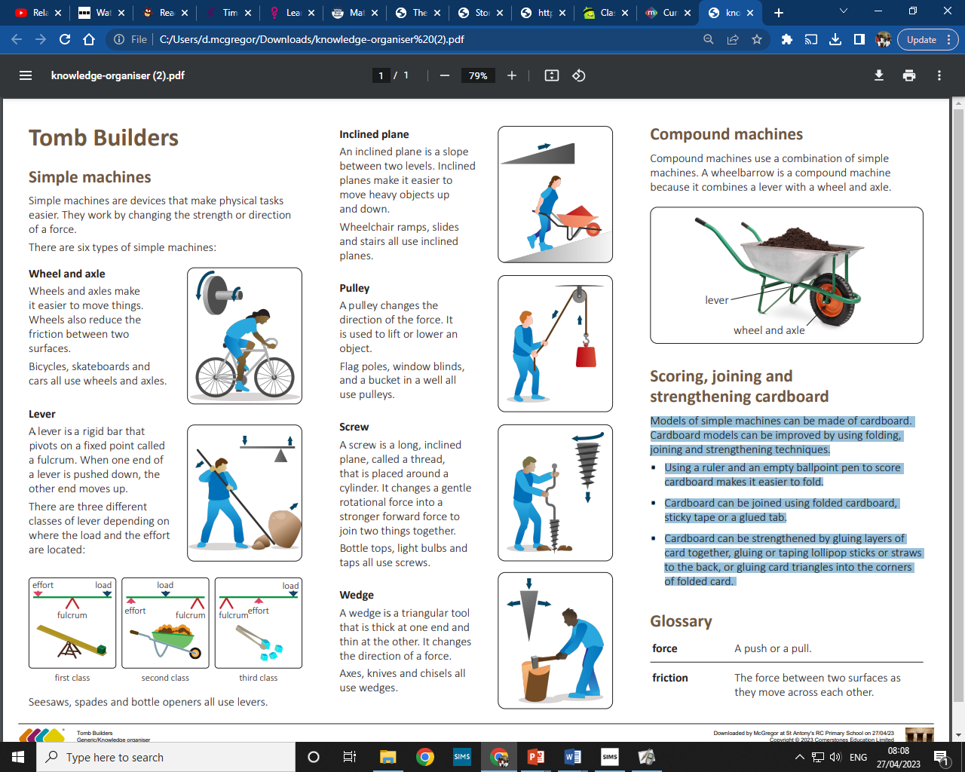
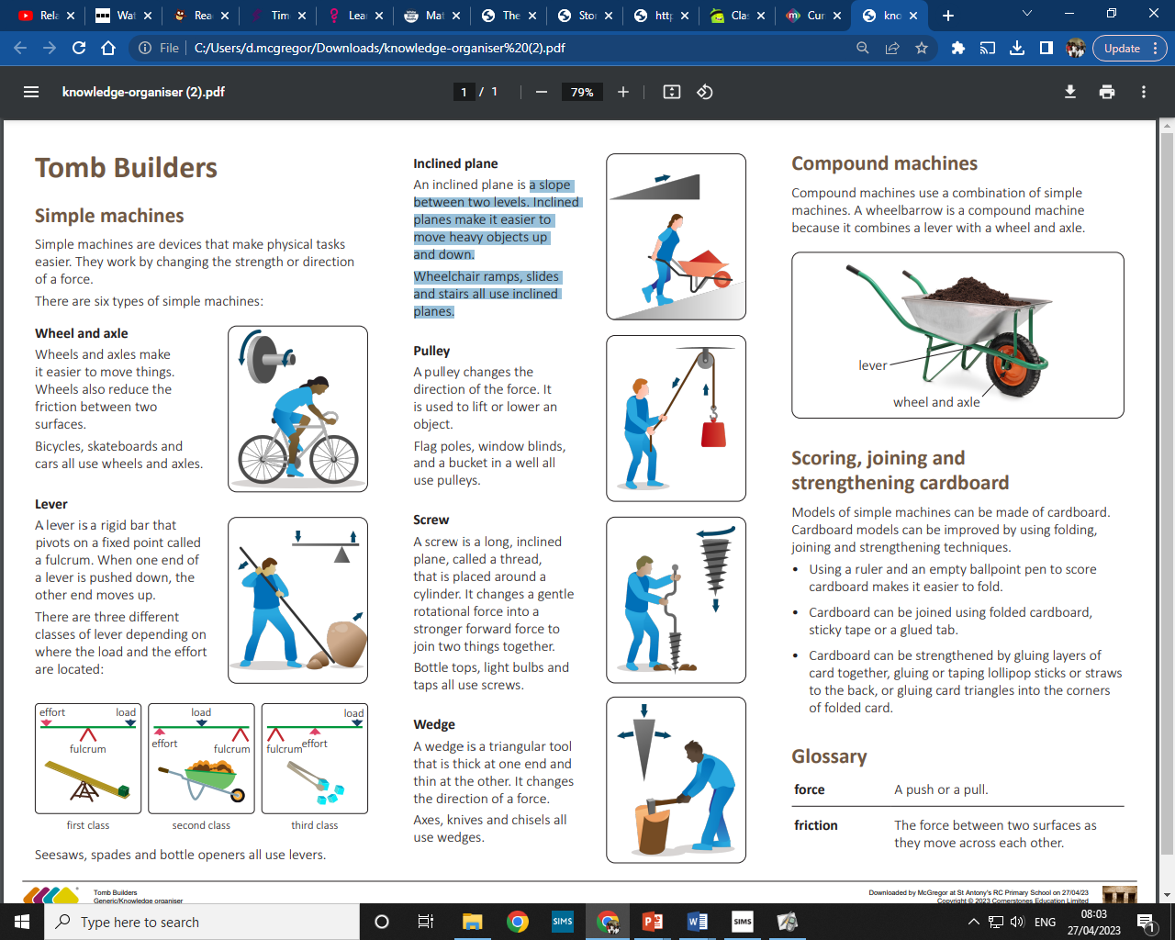
My Know And Remember More card about Tomb Builders
Key facts to remember
Ancient tomb builders, such as the Egyptians, used heavy stones to make the pyramids. They were moved by early machines.
An inclined plane is a slope that can help move heavy objects between two levels as it is a smooth surface with little friction.
A pulley can lift or lower any object, with force being placed on one point of the payload (object to move).
The Egyptians engineered their tombs so that they would be very hard to open, if found, as they contained many riches.
Egyptians used three types of tombs - mastabas, pyramids and rock-cut chambers.
Vocabulary
force | A push or a pull.
friction | The force between two surfaces as they move across each other.
Tomb | an underground chamber for burying the dead.
mastaba | a flat roofed, cuboid like structure with sloping sides for buying the Egyptian dead. They were made from mudbricks.
pyramid | a large stone structure with triangular sides - usually reserved for burying important civilians.
My memory jogger
Diagram of…
This links to… | What’s next?
History - Ancient Civilisations (Egypt) – Ancient buildings etc
Wheel/Axle
Lever
Inclined Plane
Pulley
Screw
Wedge

