Slide 1

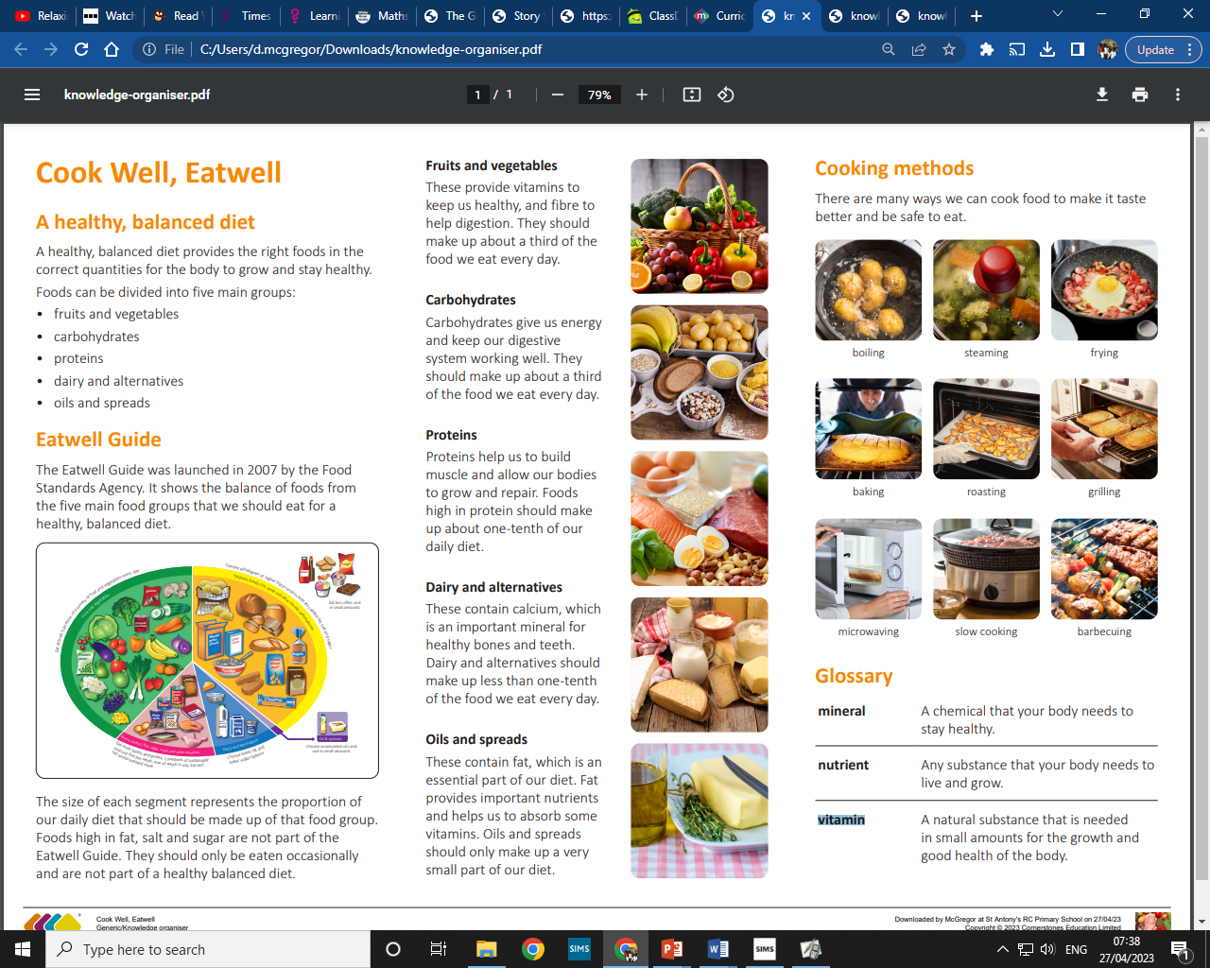
My Know And Remember More card about Healthy Bodies
Key facts to remember
Humans have to get nutrition from what they eat.
It is important to have a balanced diet made up of the main food groups, including proteins, carbohydrates, fruit and vegetables, dairy products and alternatives, and fats and spreads.
Humans need to stay hydrated by drinking water.
Key inventions in design and technology have changed the way people live.
Cooking some foods improves taste, helps digestion and kills bacteria that could be harmful for humans.
Vocabulary
mineral | A chemical that your body needs to stay healthy.
nutrient | Any substance that your body needs to live and grow.
vitamin | A natural substance that is needed in small amounts for the growth and good health of the body.
proteins | Proteins help us to build muscle and allow our bodies to grow and repair. Foods high in protein should make up about one-tenth of our daily diet.
carbohydrates | Carbohydrates give us energy and keep our digestive system working well. They should make up about a third of the food we eat every day.
My memory jogger
Diagram of… Eat Well Guide
This links to… | What’s next?
History – Through The Ages Science – Animal and Human bodies (and diets) | Tomb Builders

