Slide 1

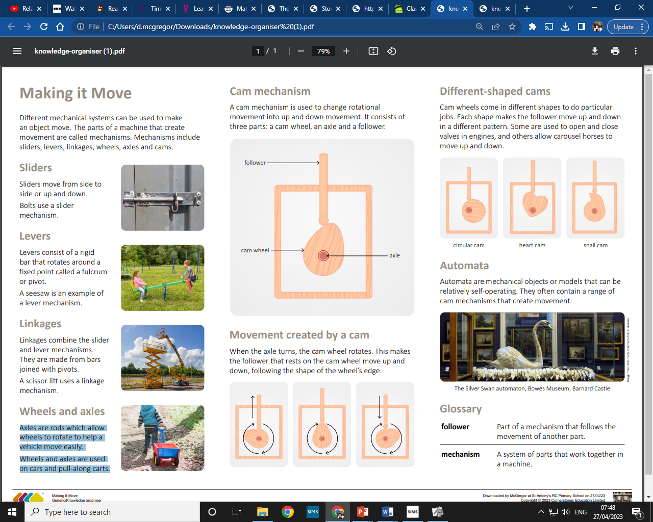
My Know And Remember More card about Making Things Move
Key facts to remember
Particular products have been designed for specific tasks, such as scissors.
Levers consist of a rigid bar that rotates around a fixed point, called a fulcrum. They reduce the amount of work needed to lift a heavy object.
Linkages combine slider (Y1) and lever mechanisms.
Cams are devices that can convert circular motion into up-and-down motion. They are attached to a bar called a follower.
As the cams are different shapes, they make the follower move up and down in a different pattern. They are called :heart cam, circular cam and snail cam.
Vocabulary
product | an item designed for usually one specific task or purpose.
cam | a device that creates an up and down motion, which usually work in a pattern of two or three.
fulcrum | the point where a lever is placed to gain traction or support.
force | strength or energy linked to action or movement
motion | movement where an object changes position.
My memory jogger
Diagram of… Cam mechanism
This links to… | What’s next?
History – Rocks, Relics & Rumbles | Healthy Bodies

