Slide 1

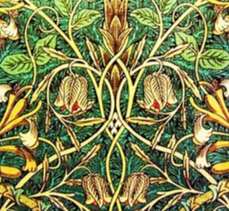
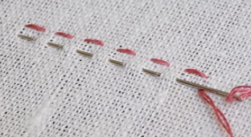
My Know And Remember More card about : Textiles : W Morris. DT
Key facts to remember
1. Fabrics can be man made or natural.
2. Cotton is from a natural source and nylon/ polyester are man made.
3. Fabrics can be joined by glueing or stitching. There are various stitches for different purposes.
4. William Morris was a classic British designer who was known for his textiles work.
5. Sewing a hem onto a garment will result in a higher quality finish..
Vocabulary
fabric | Cloth or other material made by weaving fibres
thread | A long, thin strand of cotton or to put thread through the eye of a needle.
Back stitch | One stitch backwards and two forwards.
Running stitch | Regularly spaced out stitches.
embellishment | Decorative details added to fabric.
My memory jogger
Running stitch.
Diagram of…a WM symmetrical design
This links to… | Previous Learning
Mathematics – Repeating patterns. Art – various printing tecnniques | Potato printing in reception. .

