Slide 1

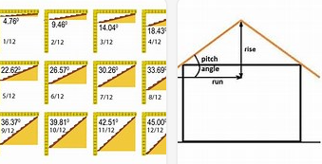
My Know And Remember More card about DT: Greenhouses
Key facts to remember
1. Greenhouses are a frame structure.
2. The stronger the base; the stronger the overall structure.
3. For a pitch roof, the needs to be 45 degree angle cuts.
4. Measurements need to be precise for a quality finish .
5. Use the correct tools and safety guidance to complete the task.
Vocabulary
Frame | A structure where the corners and upright posts are the main parts.
Hack saw | A type of small saw with sharp blade.
Mitre block | A cutting tool with 45 / 90 grooves for precision.
Pitch roof | A roof that has an agle at an elevation and is not therefore flat..
Greenhouse | Mostly transparent glass structure.
My memory jogger
Right angles are 90 degrees and 45 degrees are half. A right angled triangle is the shape of the pitch roof. Right angle at the top.
Diagram of…a frame build
This links to… | Previous Learning
Mathematics – Right angles and 45 degrees. Measurement in cm and mm. Science – sustainable products. | Measurment and recognising right angles.

