Slide 1

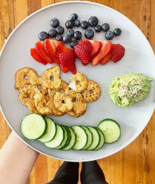
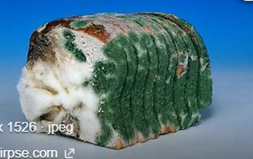
My Know And Remember More card about : Good food. DT
Key facts to remember
1. Food that is left for a while deteriorates as it is attacked by micro-organisms.
2. Freezing food will keep it fresh but it may affect taste.
3. Appearance is so importanrt if you want people to eat your food.
4. Before preparing, ensure that the area is clean and you have the correct utensils..
5. If you can grow your own vegetables and herbs, they will be pesticide free..
Vocabulary
texture | Feel or appearance of the food
taste | Flavour - : salty, sweet, spicy etc.
processed | Food that has has chemicals odded or a mechanical process too keep it freh.
seasonal | The time of year a food is available or at its best.
harvested | To take from the ground or tree (if a plant).
My memory jogger
Food begins to spoil and ‘go off’ when micro-organisms begin to break it down.
Diagram of…a healthy snack plate.
This links to… | Previous Learning
Mathematics – Right angles and 45 degree angles to create packaging. | Knowing the names of fruit and sweet/ sour..

