Slide 1

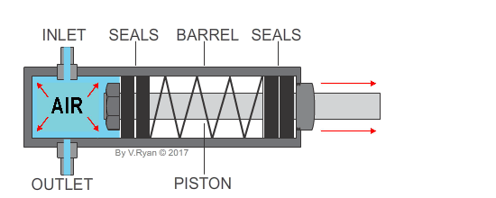
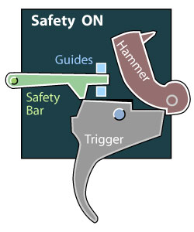
My Know And Remember More card about Dynamic Dynasties – Moving Mechanisms- DT
Key facts to remember
1. A pneumatic system uses air to exert a force.
2. Pneumatic systems use energy that is stored in compressed air to do the work.
3. Different mechanisms and systems can work together to perform a function.
4. Safety features are included and planned into designs as part of good practice.
5. Engineers test designs carefully and evaluate against set criteria before completion.
Vocabulary
Pneumatic | operated by pressure by using air or gas hydraulic: pressure controlled liquid, normally with a cylinder.
Compressed | flattened or squeezed by pressure.
Engineer | a person who designs, build or maintains machines.
Draughtsman | a person who makes detailed, technical plans or drawings.
My memory jogger
Safety mechanisms
Diagram of…
This links to… | What’s next?
Science – Engineers Raising Aspirations – careers | Y6 DT

