Slide 1

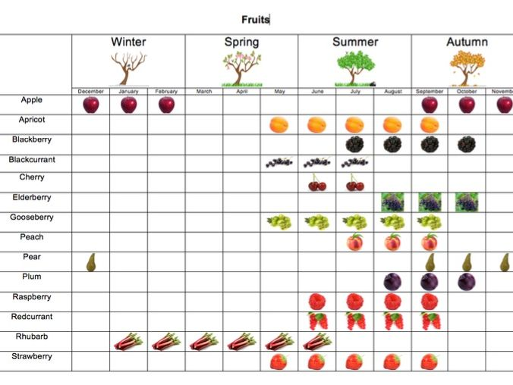
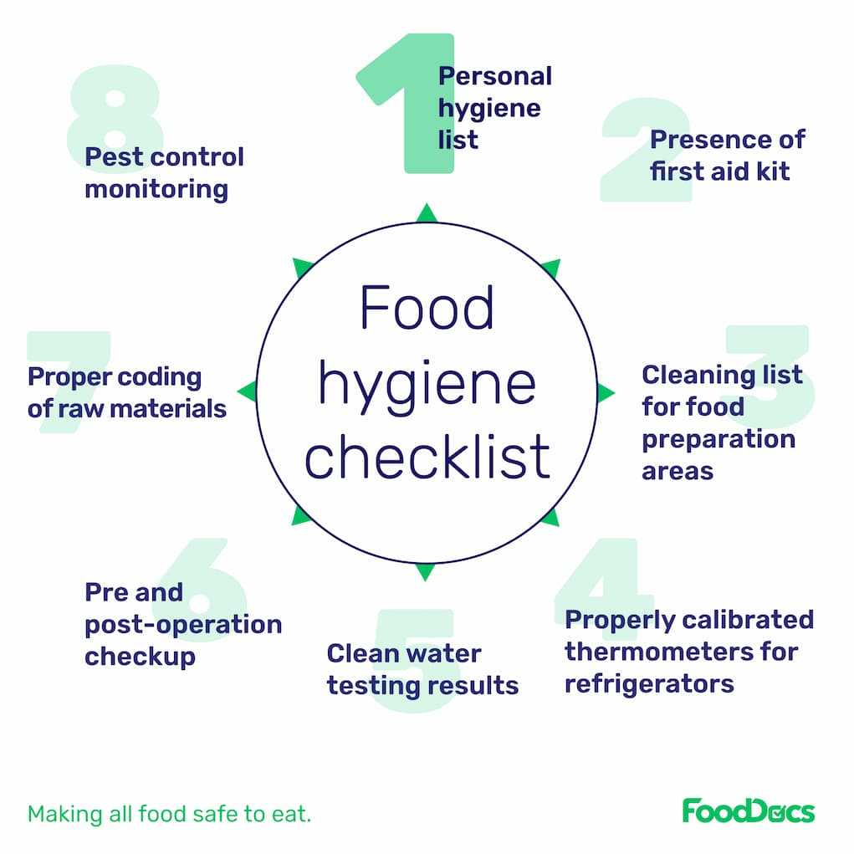
My Know And Remember More card about Sow, Grow and Farm! – Eat the Seasons– D.T
Vocabulary
Seasonality | Seasonality of food refers to the times of the year when a given type of food is at its peak, either in terms of harvest or its flavour. This is usually when the product is cheapest and freshest on the market.
Nutritional Values | Nutritional value or nutritive value as part of food quality is the measure of a well-balanced ratio of the essential nutrients carbohydrates, fat, protein, minerals, and vitamins in items of food or diet concerning the nutrient requirements of their consumer.
Sautéing | Sautéing or sautéing is a method of cooking that uses a relatively small amount of oil or fat in a shallow pan over relatively high heat.
Carbon Footprint | A carbon footprint is the total greenhouse gas emissions caused by an individual, event, organization, service, place or product, expressed as carbon dioxide equivalent.
Key facts to remember
1. Seasonality is the time of year when the harvest or flavour of a type of food is at its best.
2. Sweet dishes are usually desserts, such as cakes, fruit pies and trifles.
3. Savoury dishes usually have a salty or spicy flavour rather than a sweet one.
4. A balanced diet gives your body all of the nutrients that it needs to function correctly. This means eating a wide range of foods in the correct proportions.
5. Food hygiene is important to prevent the spread of disease-causing microorganisms.
My memory jogger
Food hygiene reminder
Diagram of…
This links to… | What’s next?
Healthy eating and a healthy body – Science Importation of foods – Geography

