Slide 1

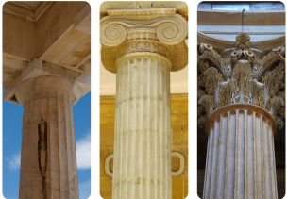
My Know And Remember More card about .....Architecture..............
Key facts to remember
Culture is the language, inventions, ideas and art of a group of people. A society is all the people in a community or group.
Culture affects the design of some products.
Prehistoric architecture : Stonehenge is an example of such, in the UK.
The Greeks were considered to be the ‘classical’ architects with their use of columns. The Romans further developed this style.
Computer aided design is now used to give an all angles view and perform safety tests before planning any construction.
Vocabulary
Barrow | a large mound of earth or stones at a burial ground.
Capital | the top part of the column that supports the what of the entablature.
Colonnade | a row of columns set at regular intervals, usually supporting a roof.
Concreate | a building material made by mixing cement, sand, small stone and water.
Industrial revolution | a period of time when work began to be done by machines rather than by human hands.
My memory jogger
Investigate and identify the design features of a familiar product. (Everyday products Y4)
Products can be improved in different ways, such as making them easier to use, more hardwearing or more attractive. (Everyday products Y2)
Diagram of… Columns
This links to… | What’s next?
Moving Mechanisms/Local Buildings (Y5) Tomb builders (Y3) | engineering materials, processes and production Preparing and planning for manufacture Computer aided manufacturing

