Slide 1
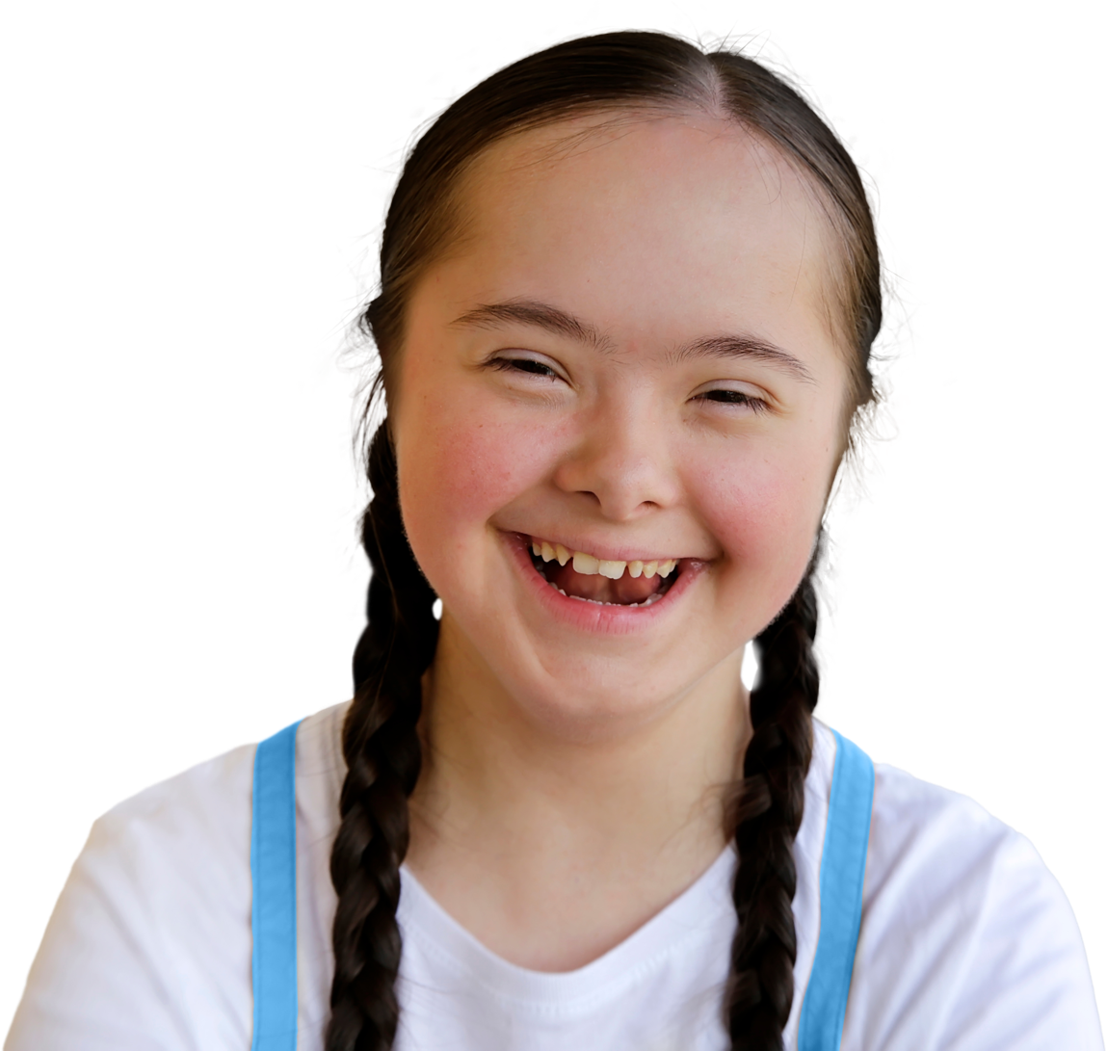



Sleep

Slide 2
Overview
Pupils explore what it means to have good sleep, what this may look like physically and how someone who has slept well might behave and feel. Pupils will learn about the benefits of good sleep to the body and think about different actions they can take to regularly get good quality sleep.
Recommended age group
Education providers for ages 10-11 (Year 6)
Time
60 minutes approximately
Preparation
Before delivering the lesson:
familiarise yourself with the film content on slides 13 and 15 of this PowerPoint
read through the classroom tips on slide 3
consider cross-curricular links
Resources
PowerPoint presentation
blank A4 paper and pencils, colouring pencils or pens
action plan template (slide 16), optional
Key vocabulary
Sleep, good quality, poor quality, rest, health, mood (feelings),
recovery (feeling better), memory (remembering) and routine (usual)
Follow up
You may wish to extend pupils’ learning with one of the extended
learning projects on slide 21.
Visit MindEd for further reading for teachers, parents or carers
on sleep in young people. You may need to sign up to access this item.
Notes:
Teacher Only (To be removed when no longer applicable)

Slide 3
Classroom tips
Climate for learning
Read through Guidance for Learning in a Safe Environment.
This includes advice on:
developing and revisiting effective ground rules drawn up with pupils
familiarity with your school’s safeguarding policy and procedures, including Child Protection and other relevant policies
being prepared in case pupils make a disclosure
including and protecting vulnerable pupils
using distancing techniques so that pupils can discuss sensitive issues without being encouraged to make a disclosure
handling sensitive questions
involving pupils with special educational needs and disabilities (SEND) and/or autism
You may also wish to familiarise yourself with any schemes or offers available in your school, organisation or local area to support young people’s mental health which clearly links to the promotion of healthy sleep habits. Your local public health team or school nurse should be able to help signpost you to local sources of support.
Anonymous question box
Place a question box or envelope somewhere in the classroom.
Pupils write down any questions that occur to them during the
lesson and submit them anonymously. You can address these questions in the next lesson.
Notes:
Teacher Only (To be removed when no longer applicable)

Slide 4
Social distancing
Adapting lessons to social distancing
Please refer to the Government guidelines and your own school’s advice.
Where pair or small group discussions aren’t possible, replace with personal reflections or individual contributions to whole class discussions.
Activity 1 (Slide 8): Why do we sleep?
This activity can be completed by pupils making individual notes or could be played as a whole class memory game where pupils are shown the infographics and then as a whole class they must work collectively to remember the key points which can be recorded by the teacher on the board. The mini-speeches could be given to the whole class instead of small groups.
Activity 2 (Slide 13): Good quality sleep vs. poor quality sleep
It is recommended this is done as a whole class activity, with half the class covering good quality sleep and half covering poor quality sleep. Pupils could write or draw their ideas on mini-whiteboard and hold these up to give their feedback which could then be added to the board.
Activity 3 (Slide 15): The better sleep action plan
This activity could be completed individually. Colouring pencils could be used to help pupils get creative.
Preparation
Returning to school and managing the changes that have come about in their lives because of Covid-19 will have posed many different challenges for young people. It will have affected every young person differently and it will be more important than ever before for pupils to have a safe space to explore their feelings and experience.
Reassure pupils that it’s normal to worry about the impact of Covid-19 and that everyone will have had different responses. For example, some may have experienced loneliness, while others may have enjoyed lockdown – for many, there will have been a mixture of different emotions.
There is clear guidance for teaching sensitive issues in the Guidance for Learning in a Safe Environment document and it is important that this is read before delivering this lesson.
Notes:
Teacher Only (To be removed when no longer applicable)

Slide 5


What are we learning?
Learning outcomes
Learning objectives
Key vocabulary
sleep
good quality
poor quality
rest
health
mood (feelings)
recovery (feeling better)
memory (remembering)
routine (usual)
We will be able to…
list some benefits of good quality sleep
explain how sleep can affect a young person’s wellbeing
describe actions a young person can take to help improve their quality of sleep
We are exploring the benefits of good quality sleep and learning about actions we can take to get it.
Notes:
Please note that this slide contains animated content and is best viewed in presentation mode.
Briefly share the learning objectives, outcomes and key vocabulary with pupils. For key vocabulary, note that easier-to-understand alternative words are provided in the brackets.

Slide 6
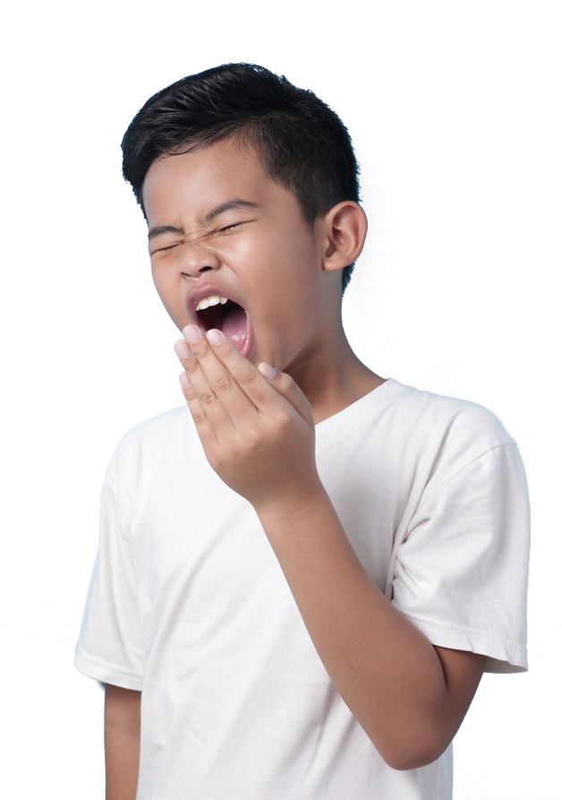
All about sleep
At age 10, children are recommended to get around 10 hours of sleep each night.
At age 10, children are recommended to get around ….. hours of sleep each night.
The average person spends 9,582 days of their lifetime asleep.
The average person spends ….. days of their lifetime asleep.
A good night’s sleep can improve
a person’s mood, memory
and health.
A good night’s sleep can improve
a person’s ………… , …………
and ………….
Did you know?
You spend roughly one
third of your life asleep!
Notes:
Lesson stimulus (3-4 mins)
Show these sentences with missing information as pupils enter the classroom. Can pupils think what the missing words could be? Click to reveal the missing information.
Extension question: Why do you think we sleep?

Slide 7
How confident are you in…
10
Extremely confident
9
8
7
6
listing some benefits of good
quality sleep?
explaining how sleep can affect a young person’s wellbeing?
describing actions a young person can take to help improve their quality of sleep?
5
4
3
2
1
0
Not confident
Notes:
Baseline assessment: How do you feel? (3-4 mins)
Show pupils the three statements and ask them to rate their confidence in each using a scale from 0-10.
There are lots of ways you might do this activity. Pupils could respond to the statements individually by writing their three numbers down on paper, or verbally by discussing their feelings in pairs/groups. Alternatively, you could ask pupils to reflect silently, before holding up the relevant number of fingers in response to each statement.
How confident are you in:
listing some benefits of good quality sleep?
explaining how sleep can affect a young person’s wellbeing?
describing actions a young person can take to help improve their quality of sleep?
Use this initial assessment to decide whether you might need to adapt the lesson content to extend or support pupils, depending on their starting point.

Slide 8

Why do we sleep?
Imagine you have a chance
to speak in assembly.
Can you explain the benefits
of sleep in just 30 seconds?
Did you know?
Dolphins go to sleep with
just one side of their brain?!
Notes:
Activity 1: Why do we sleep? (15 mins, slides 8-12)
Ask pupils to imagine that they have been given a short chance to speak in assembly. They will have just 30 seconds to tell the rest of the school about the benefits of sleep. They can do this as individuals, in pairs or in small groups.
As a class, read through the information on the next two slides on why we need to sleep.
Fun fact: Did you know that dolphins go to sleep with just one side of their brain? The other side stays awake to keep them swimming and to watch out for predators

Slide 9

Sleep helps the brain function
A good night's sleep helps...
Memory
Overnight, information moves from short-term to long-term memory.
Decision making
Our ability to think and make
decisions is improved during sleep.
Concentration and mood
While asleep, activity in the brain improves a person’s focus.
Notes:
Activity 1: Why do we sleep? (15 mins) continued
Explain to pupils that sleep has a positive impact on the brain. For example, a good night’s sleep improves memory – overnight, information moves from our short-term to our long-term memory which helps us learn.

Slide 10

Sleep helps the body function
A good night’s
sleep helps the...
Immune system
The immune system keeps a person healthy.
Body feel full after eating
This means a person who sleeps well
is more likely to stay a healthy weight.
Body to grow and repair
During sleep the body repairs
its muscles, organs and other cells.
Notes:
Activity 1: Why do we sleep? (15 mins) continued
Explain that sleep regulates the way messages travel between our brain and other parts of our body. For example, sleep helps the body function by supporting the immune system, helping the body recognise it is full and by helping the body to grow and repair.

Slide 11

Think about
Imagine you have a chance to speak in assembly.
Can you explain the benefits
of sleep in just 30 seconds?
Notes:
Activity 1: Why do we sleep? (15 mins) continued
Give pupils time to make their speeches, as individuals or in pairs or small groups.
Optional challenge: If there are pupils in the class whose verbal skills are very strong an additional challenge can be given. Pupils cannot hesitate and/or say errrr or ummmm during their 30 second speech. If there is a gap, then another person in the pair or group has a go. This does not have to be undertaken by pupils if the facilitator does not deem it to be an appropriate task.
For extra support: Print slides 9-10 out for pupils, so they have all of the information in front of them and organise pupils in mixed ability pairs or groups. Young people with language difficulties may benefit from these support options.

Slide 12

Discussion questions
Challenge:
Why do you think a two
year old or a teenager needs more sleep than an adult?
Are rest and sleep
the same thing?
All
Which benefit(s) of sleeping were you most surprised about? Why?
What might a person
be like when they have slept well?
Notes:
Activity 1: Why do we sleep? (15 mins) continued
Show pupils the discussion questions and give them a few moments of thinking time before asking them to discuss in pairs before feeding back as a whole class.
Which benefit(s) of sleeping were you most surprised about? Why?
What might a person be like when they have slept well?
For example, they might be in a good mood, able to concentrate and make decisions easily, feeling healthy and able to remember lots from yesterday!
Challenge questions:
Why do you think a two year old or a teenager needs more sleep than an adult?
The younger you are, the more sleep you need. This is because children and teenager’s brains and bodies are still growing and a lot of the most important growing and repairing in our brain and body happens while asleep.
Are rest and sleep the same thing?
No, rest might be just closing your eyes or lying down, while someone who is sleeping is unconscious but can be woken by a strong enough stimulus, such as a loud noise.

Slide 13
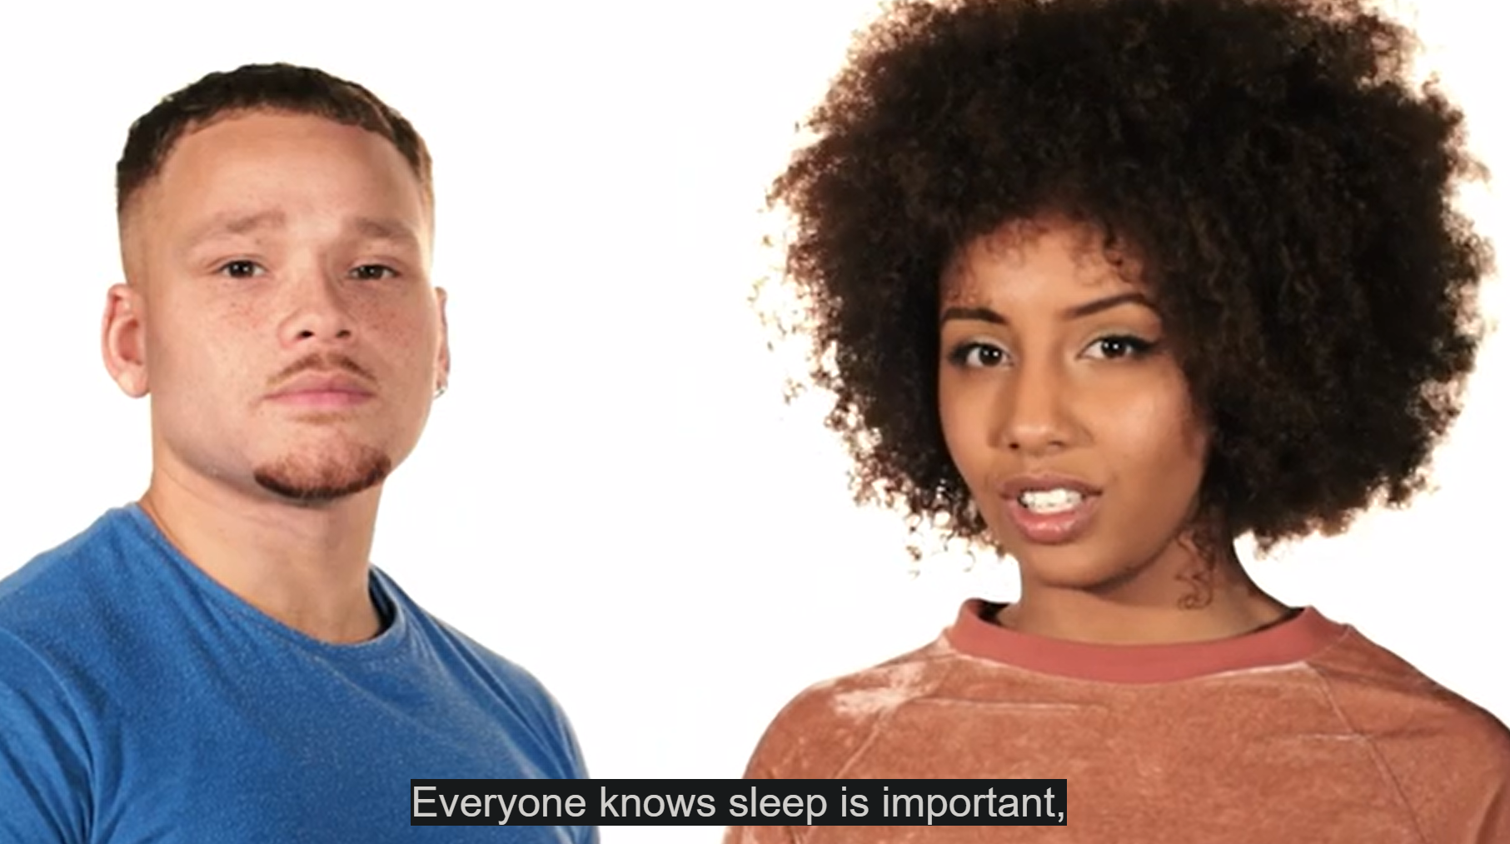
Good quality vs. poor quality sleep
Watch the first
part of this video.
Be ready to list some ways sleep can affect how a person looks, feels and behaves.
Notes:
Activity 2: Good quality sleep vs. poor quality sleep (10 mins, slides 13-14)
Tell pupils that after they have watched the first part of the video (stopping at 01:28), you will be asking them to list the ways people look, feel and behave when they have or have not had enough sleep.
You can play the ‘Sleep’ video by copying and pasting this URL into your web browser: https://bcove.video/2LqyUDq

Slide 14
Good quality vs. poor quality sleep
Good quality sleep
How might a person who has slept well:
Poor quality sleep
How might a person who has not slept well:
Look?
Feel?
Behave?
Look?
Feel?
Behave?
Notes:
Activity 2: Good quality sleep vs. poor quality sleep (10 mins) continued
You could do this activity as a class, with pupils listing ideas from the video under each heading or one half of the class doing the list of ‘good quality sleep’ and the other doing the list for ‘poor quality sleep’.
Further challenge: Ask pupils to consider what might prevent good quality sleep.

Slide 15
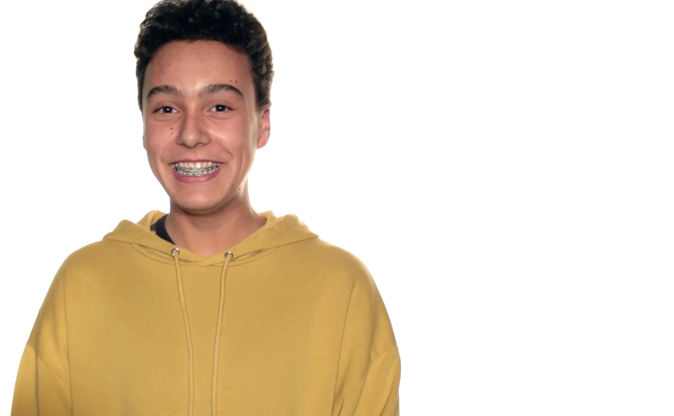
The better sleep action plan
Watch the second
part of this video.
Look out for actions a person can take to improve their sleep.
Notes:
Activity 3: The better sleep action plan (15 mins, slides 15-17)
Share the second half of the video with pupils (from 01:28). You can play the video by copying and pasting this link into your web browser: https://bcove.video/2LqyUDq
This time you will be asking them to list some of the different actions they have learned that might encourage better quality sleep.
Ask pupils to share their ideas as a class. You may wish to write the ideas up so pupils can refer to them for the next activity. Actions mentioned in the video include limiting screen time, being active during the day and using relaxation techniques like calming music, reading or using earplugs or an eye mask.

Slide 16
Action plan
Daytime routine
Bedtime routine
Can you design an action plan to help a young person to improve their quality of sleep?
Draw or write one thing
in each box.
Bedroom environment
Top tip for better sleep
Notes:
Activity 3: The better sleep action plan (15 mins) continued
Tell pupils that they need to help a Year 6 child who is having trouble sleeping.
Can they design an action plan to help them to improve their quality of sleep?
To create their action plan, pupils can:
Fold a piece of paper into four boxes
Write a different label in each of the four boxes: Daytime routine, Bedtime routine, Bedroom environment, Top tip for better sleep.
Draw or write one thing for each heading that would help the Year 6 child to get better quality sleep.
If pupils need support, use the ideas bank on the following slide.

Slide 17

Ideas bank
Daytime routine
eating a balanced diet
exercise
tidying
resting
creativity (drawing, painting, craft)
spending time with family/friends
contact with animals/pets
Night time routine
limit screen-time before bed
brushing teeth
reading or listening to a book
stretches
relaxing music
spray a nice scent
washing
Top tips for better sleep
breathing exercises to slow down
breathing and help you to relax
writing any worries down
in a diary/book
thinking of good things that
happened in the day
talking to someone trusted about
anything that is on your mind
Notes:
Activity 3: The better sleep action plan (15 mins) continued
Please note that this slide contains animated content and is best viewed in presentation mode.
Use this ideas bank to support pupils with their action plan if needed.
If pupils struggle with worries at bedtime, the What to do about worry relaxation activities could also be useful: https://campaignresources.phe.gov.uk/schools/resources/what-to-do-about-worry-year6-lesson-plan-pack

Slide 18
How confident are you in…
10
Extremely confident
9
8
7
6
listing some benefits of good quality sleep?
explaining how sleep can affect
a young person’s wellbeing?
describing actions a young person can take to help improve their quality of sleep?
5
4
3
2
1
0
Not confident
Notes:
Assessment for learning (3-4 mins)
Show pupils the three statements from the initial assessment once more and ask pupils to rate their confidence in each now they have completed the lesson.
It is an opportunity for pupils to reflect on what they have learned in the lesson. Ask pupils to consider why their scores have changed and give an example of something new they have learned or thought about.
How confident are you in:
listing some benefits of good quality sleep?
explaining how sleep can affect a young person’s wellbeing?
describing actions a young person can take to help improve their quality of sleep?

Slide 19

Think about…
…something new you have learned today.
Can you write your own
'Did you know' fact?
Notes:
Plenary: Bedtime (3 mins)
Ask pupils to think about what they have learned in today’s lesson and write their own ‘Did you know...’ fact.
Pupils could share their fact with the person next to them or the whole class or write it down on the back of their action plan.

Slide 20
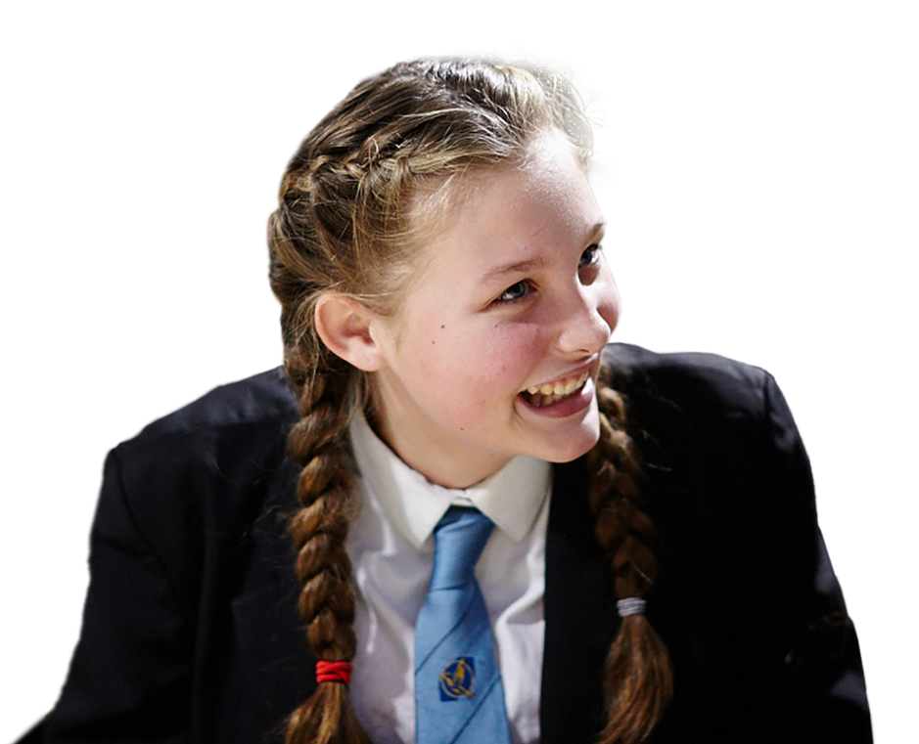
It can be common to struggle with sleep
If you are worried about it or if a lack of sleep is making things difficult, you can speak to a trusted adult or ask them to make you an appointment with your GP.
Childline: childline.org.uk/info-advice
or call 0800 1111
Shout: text 85258
Notes:
Signposting (1 min)
Finally, let pupils know that everybody is different when it comes to sleep. Sometimes, people might struggle with falling asleep or with staying asleep. If pupils are having difficulty with sleep, they can use the different actions they have learned in the lesson or they can speak to an adult they trust – like a family member at home or a teacher.
If they are worried about it or if a lack of sleep is making things difficult, pupils can also ask a trusted adult to make them an appointment with a GP.
Pupils can also contact Childline; a free, confidential service where they can talk about anything that might be worrying them and it will be kept confidential. They also have sleep advice: https://www.childline.org.uk/info-advice/your-feelings/feelings-emotions/problems-sleeping/.
Shout is a free and confidential text messaging service to support mental health and emotional wellbeing that can be used anytime, day or night.

Slide 21
Extended learning projects
Now that pupils have made an action plan for another Year 6 pupil, see if they can make one for themselves using this action plan as a template. This can be set as a homework task.
Ask your class to share what they have learned in a whole school assembly. Pupils could choose how they present, for example a series of 30 second speeches, a performance or a PowerPoint presentation.
As a class, or as individuals, pupils could create a survey to find out other people’s ideas on actions that can promote better quality sleep. Ideas collected could be compared as a class and discussed. This is a nice activity to emphasise that different strategies work for different people.
Ask pupils to write an article for the school newsletter or school magazine. They could include the benefits of sleep and top tips for getting better sleep.
Notes:
Extended learning projects
These can be given to pupils as projects to extend their learning, these could be done either in school or at home.

