Slide 1

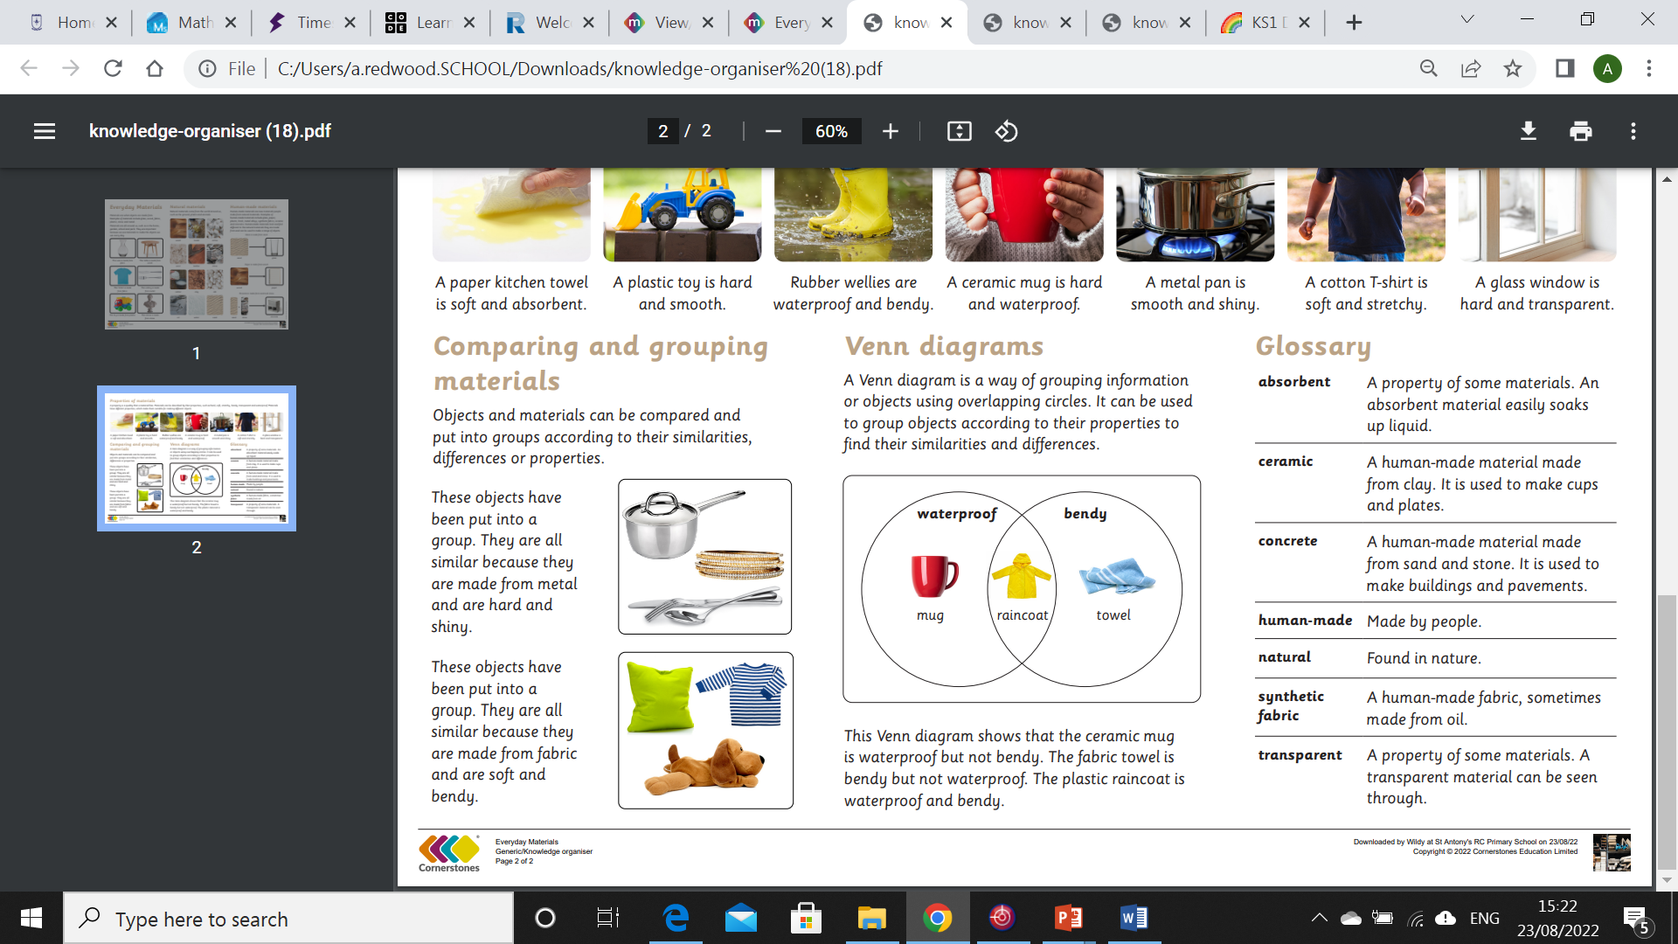
My Know And Remember More card about - Everyday Materials
Key facts to remember
1. All objects are made of one or more materials.
2. Human-made materials are materials people create from natural materials.
3. A property is a quality that a material has.
4. Materials can be described by their properties.
Vocabulary
Absorbent | A property of some materials. An absorbent material easily soaks up liquid.
See-through | A material you can see through.
Synthetic | A human-made fabric, sometimes made from oil.
Waterproof | Something that keeps water out.
Object | A material or thing that can be seen or touched.
Working Scientifically
observing closely, using simple equipment. identifying and classifying
My memory jogger
Prior Learning… | Future Learning…
Use all their senses in hands-on exploration of natural materials. (Nursery – Materials) Explore collections of materials with similar and/or different properties. (Nursery – Materials) Talk about the differences between materials and changes they notice. (Nursery – Materials). | Identify and compare the suitability of a variety of everyday materials, including wood, metal, plastic, glass, brick, rock, paper and cardboard for particular uses. (Y2 - Uses of everyday materials) Find out how the shapes of solid objects made from some materials can be changed by squashing, bending, twisting and stretching. (Y2 - Uses of everyday materials)

