Slide 1

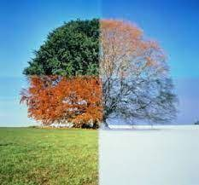
My Know And Remember More card about - Seasonal Changes
Key facts to remember
1. In the UK, the longest day is in the summer.
2. The day gets shorter each day from mid-summer until mid-winter.
3. The weather changes with the seasons.
4. The change in weather causes many other changes such as where mini-beasts live.
Vocabulary
Day length | The time between sunrise and sunset.
Sunset | The time in the evening when the sun sets.
Sunrise | The time in the morning when the sun appears or full daylight arrives.
Working Scientifically
observing closely, using simple equipment. gathering and recording data to help in answering questions.
My memory jogger
Prior Learning… | Future Learning…
Understand the key features of the life cycle of a plant and an animal. (Nursery – Plants & Animals, excluding humans) Explore the natural world around them. (Reception – Seasonal changes) Describe what they see, hear and feel whilst outside. (Reception – Seasonal changes) Understand the effect of changing seasons on the natural world around them. (Reception – Seasonal changes) | Recognise that light from the sun can be dangerous and that there are ways to protect their eyes. (Y3 - Light) Use the idea of the Earth’s rotation to explain day and night and the apparent movement of the Sun across the sky. (Y5 - Earth and space) The seasons and the Earth’s tilt, day length at different times of year, in different hemispheres. (KS3)

