Slide 1

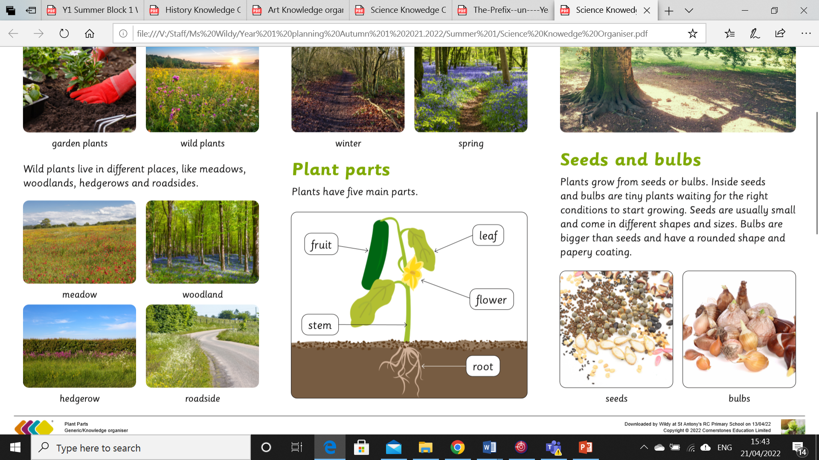
My Know And Remember More card about - Plants
Key facts to remember
1. Plants have specific names.
2. Plants have common parts.
3. Some trees keep their leaves all year.
4. Some trees lose their leaves in different seasons.
5. Names of plants can be identified by looking at their key characteristics.
Vocabulary
Bark | The tough, woody out covering of a tree’s trunk, roots and branches.
Stem | The main structure of a plant
Seeds | Plants grow from small seeds.
Bulbs | the name given to the underground bud or stem of a seed plant at resting stage
Blossom | A flower or mass of flowers, especially on a tree or bush.
Working Scientifically
using their observations and ideas to suggest answers to questions. identifying and classifying.
My memory jogger
Prior Learning… | Future Learning…
Plant seeds and care for growing plants. (Nursery – Plants) Understand the key features of the life cycle of a plant and an animal. (Nursery – Plants) Begin to understand the need to respect and care for the natural environment and all living things. (Nursery – Plants) Explore the natural world around them. (Reception – Living things and their habitats) Recognise some environments that are different to the one in which they live. (Reception – Living things and their habitats) | Observe and describe how seeds and bulbs grow into mature plants. (Y2 - Plants) Find out and describe how plants need water, light and a suitable temperature to grow and stay healthy. (Y2 - Plants) Identify and name a variety of plants and animals in their habitats, including microhabitats. (Y2 - Living things and their habitats) Identify and describe the functions of different parts of flowering plants: roots, stem/trunk, leaves and flowers. (Y3 - Plants) Investigate the way in which water is transported within plants. (Y3 - Plants)

