Slide 1

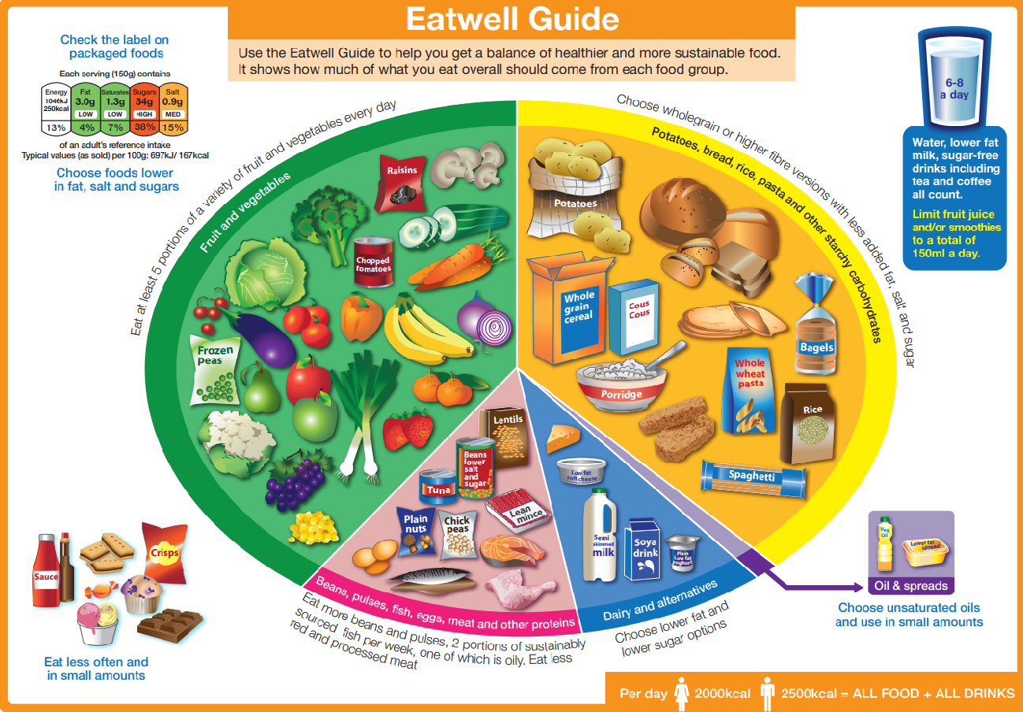
My Know And Remember More card about – Animals Including Humans (Humans)
Key facts to remember
1. Humans have offspring which grow into adults.
2. Humans have the basic need of feeding, drinking and breathing that must be satisfied in order to survive.
3. For humans to grow into healthy adults, they need the right amounts and types of food and exercise.
4. Good hygiene is important in preventing infection.
Vocabulary
Offspring | The child of an animal.
Young | Offspring that has not reached adulthood.
Reproduction | To produce more of the same thing.
Hygiene | The way we care for our bodies to prevent disease or illness.
Germs | A microorganism which causes disease.
Exercise | Activity requiring physical effort.
Working Scientifically:
observing closely, using simple equipment. asking simple questions and recognising that they can be answered in different ways.
My memory jogger
Prior Learning… | Future Learning…
Identify and name a variety of common animals that are carnivores, herbivores and omnivores. (Y1 - Animals, including humans) Identify, name, draw and label the basic parts of the human body and say which part of the body is associated with each sense. (Y1 - Animals, including humans) | Identify that animals, including humans, need the right types and amount of nutrition, and that they cannot make their own food; they get nutrition from what they eat. (Y3 - Animals, including humans) Describe the differences in the life cycles of a mammal, an amphibian, an insect and a bird. (Y5 - Living things and their habitats) Describe the life process of reproduction in some plants and animals. (Y5 - Living things and their habitats) Recognise the impact of diet, exercise, drugs and lifestyle on the way their bodies function. (Y6 - Animals, including humans)

