Slide 1

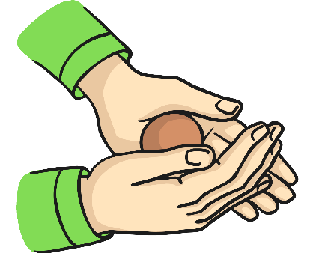


My Know And Remember More card about – Uses of Everyday Materials
Key facts to remember
1. All objects are made of one or more materials that are chosen specifically because they have suitable properties for the task.
2. A material can be suitable for different purposes.
3. An object can be made of different materials.
4. Objects made of some materials can be changed in shape by bending, stretching, squashing and twisting.
5. When choosing what to make an object from, the properties needed are compared with the properties of the possible materials.
Vocabulary
Opaque | Cannot see through it
Transparent | Can see through it
Translucent | Some light passes through it but it is not see through
Flexible | Bends easily without breaking
Rigid | Hard to bend, not flexible
Reflective | Can reflect light
Non-reflective | Cannot reflect light
Prior Learning… | Future Learning…
Distinguish between an object and the material from which it is made. (Y1 - Everyday materials) Identify and name a variety of everyday materials, including wood, plastic, glass, metal, water, and rock. (Y1 - Everyday materials) Describe the simple physical properties of a variety of everyday materials. (Y1 - Everyday materials) Compare and group together a variety of everyday materials on the basis of their simple physical properties. (Y1 - Everyday materials) | Compare and group together different kinds of rocks on the basis of their appearance and simple physical properties. (Y3 - Rocks) Notice that some forces need contact between two objects, but magnetic forces can act at a distance. (Y3 - Forces and magnets) Compare and group together everyday materials on the basis of their properties, including their hardness, solubility, transparency, conductivity (electrical and thermal), and response to magnets. (Y5 - Properties and changes of materials) Give reasons, based on evidence from comparative and fair tests, for the particular uses of everyday materials, including metals, wood and plastic. (Y5 - Properties and changes of materials)
Working Scientifically
identifying and classifying. using their observations and ideas to suggest answers to questions.
My memory jogger
Squashing Bending

