Slide 1

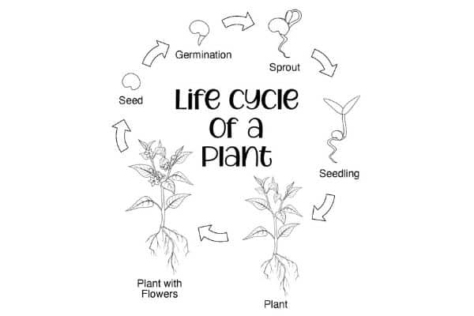
My Know And Remember More card about – Plants
Key facts to remember
1. Plants may grow from either seeds or bulbs.
2. Seeds and bulbs need to be planted outside at particular times of year and they will germinate and grow at different rates.
3. Some plants are better suited to growing in full sun and some grow better in partial or full shade.
4. Plants need different amounts of water and space to grow well and stay healthy.
5. Mature plants may have flowers which then develop into seeds, berries, fruits etc.
Vocabulary
Germination | The growth of a plant contained in a seed.
Shade | Darkness caused by shelter from direct sunlight.
Healthy | In a good condition.
Cool | Fairly low temperature.
Warm | Fairly high temperature.
Working Scientifically
observing closely, using simple equipment. identifying and classifying.
My memory jogger
Prior Learning… | Future Learning…
Identify and name a variety of common wild and garden plants, including deciduous and evergreen trees. (Y1 - Plants) Identify and describe the basic structure of a variety of common flowering plants, including trees. (Y1 - Plants) | Identify and describe the functions of different parts of flowering plants: roots, stem/trunk, leaves and flowers. (Y3 - Plants) Explore the requirements of plants for life and growth (air, light, water, nutrients from soil, and room to grow) and how they vary from plant to plant. (Y3 - Plants) Investigate the way in which water is transported within plants. (Y3 - Plants) Explore the part that flowers play in the life cycle of flowering plants, including pollination, seed formation and seed dispersal. (Y3 - Plants)

