Slide 1

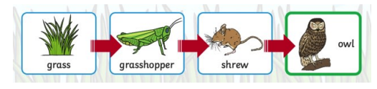
My Know And Remember More card about – Living Things and Their Habitats
Key facts to remember
1. All objects are either living, dead or have never been alive.
2. Living things are plants (including seeds) and animals. Dead things include dead animals and plants and parts of plants and animals that are no longer attached.
3. Animals and plants live in a habitat to which they are suited.
4. The habitat provides the basic needs of the animals and plants – shelter, food and water.
5. Within a habitat there are different micro-habitats e.g. in a woodland – in the leaf litter, on the bark of trees, on the leaves.
Vocabulary
Suited | right or appropriate for a particular person, purpose, or situation.
Food chain | a series of organisms each dependent on the next as a source of food.
Habitat | the natural home or environment of an animal, plant, or other organism.
Shelter | a place giving temporary protection from bad weather or danger.
Prior Learning… | Future Learning…
Identify and name a variety of common wild and garden plants, including deciduous and evergreen trees. (Y1 - Plants) Identify and describe the basic structure of a variety of common flowering plants, including trees. (Y1 - Plants) Identify and name a variety of common animals including fish, amphibians, reptiles, birds and mammals. (Y1 - Animals including humans) Identify and name a variety of common animals that are carnivores, herbivores and omnivores. (Y1 - Animals including humans) Describe and compare the structure of a variety of common animals (fish, amphibians, reptiles, birds and mammals, including pets). (Y1 – Animals, including humans) Observe changes across the four seasons. (Y1 - Seasonal changes) | Recognise that living things can be grouped in a variety of ways. (Y4 - Living things and their habitats) Explore and use classification keys to help group, identify and name a variety of living things in their local and wider environment. (Y4 - Living things and their habitats) Recognise that environments can change and that this can sometimes pose dangers to living things. (Y4 - Living things and their habitats) Construct and interpret a variety of food chains, identifying producers, predators and prey. (Y4 - Animals, including humans)
Working Scientifically
observing closely, using simple equipment. asking simple questions and recognising that they can be answered in different ways.
My memory jogger

