Slide 1

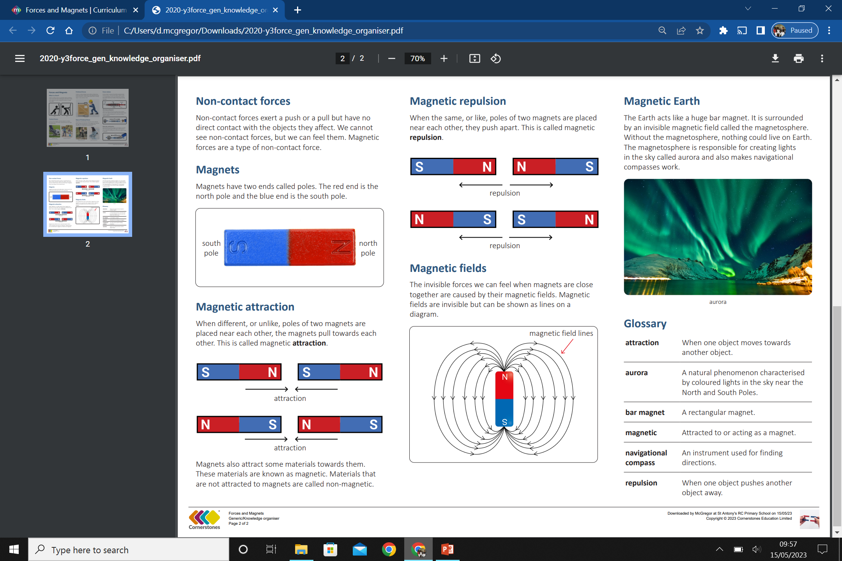
My Know And Remember More card about - Forces & Magnets
Key facts to remember
1. A force is a push or a pull.
2. When an object moves on a surface, the texture of the surface and the object affect how it moves.
3. A magnet attracts magnetic material.
4. The strongest parts of a magnet are the poles.
5. Magnets have two poles – a north pole and a south pole.
Vocabulary
Attract | to draw by a physical force causing or tending to cause to approach, adhere, or unite.
Repel | to force (something) to move away or apart.
Texture | how something feels, including its appearance and consistency.
Poles | one of two ends of a Magnet, with magnets having a North and a South pole.
Working Scientifically
setting up simple practical enquiries, comparative and fair tests. gathering, recording, classifying and presenting data in a variety of ways to help in answering questions.
My memory jogger…
Prior Learning… | Future Learning…
Explore how things work. (Nursery – Forces) Explore and talk about different forces they can feel. (Nursery – Forces) Talk about the differences between materials and changes they notice. (Nursery – Forces) Explore the natural world around them. (Reception – Forces) Describe what they see, hear and feel whilst outside. (Reception – Forces) Find out how the shapes of solid objects made from some materials can be changed by squashing, bending, twisting and stretching. (Y2 - Uses of everyday materials) | Explain that unsupported objects fall towards the Earth because of the force of gravity acting between the Earth and the falling object. (Y5 - Forces) Identify the effects of air resistance, water resistance and friction, that act between moving surfaces. (Y5 - Forces) Recognise that some mechanisms, including levers, pulleys and gears, allow a smaller force to have a greater effect. (Y5 - Forces) Magnetic fields by plotting with compass, representation by field lines. (KS3) Earth’s magnetism, compass and navigation. (KS3)

