Slide 1

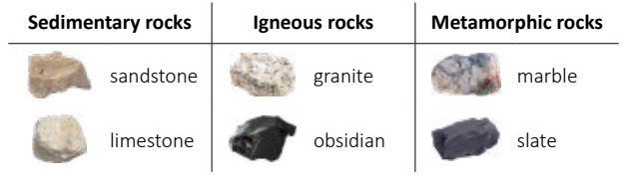
My Know And Remember More card about - Rocks
Key facts to remember
1. Rock is a naturally occurring material.
2. There are different types of rock e.g, sandstone, limestone, slate etc. which have different properties.
3. Rocks can be hard or soft and they have different sizes of grain or crystal which may absorb water.
4. Soils are made up of pieces of ground down rock which may be mixed with plant and animal material (organic matter).
5. Some rocks contain fossils which were formed millions of years ago.
Vocabulary
Grain | mineral crystals or sediment particles that make up all rocks.
Absorb | take in or soak up.
Fossil | the remains or impression of a prehistoric plant or animal embedded in rock and preserved in petrified form.
Layers | a sheet, quantity, or thickness of material, typically one of several, covering a surface or body.
Working Scientifically
asking relevant questions and using different types of scientific enquiries to answer them. making systematic and careful observations.
My memory jogger…
Prior Learning… | Future Learning…
Distinguish between an object and the material from which it is made. (Y1 - Everyday materials) Identify and name a variety of everyday materials, including wood, plastic, glass, metal, water, and rock. (Y1 - Everyday materials) Describe the simple physical properties of a variety of everyday materials. (Y1 - Everyday materials) Compare and group together a variety of everyday materials on the basis of their simple physical properties. (Y1 - Everyday materials) Identify and compare the suitability of a variety of everyday materials, including wood, metal, plastic, glass, brick, rock, paper and cardboard for particular uses. (Y2 - Uses of everyday materials) | Recognise that living things have changed over time and that fossils provide information about living things that inhabited the Earth millions of years ago. (Y6 - Evolution and inheritance) The composition of the Earth. (KS3) The structure of the Earth. (KS3) The rock cycle and the formation of igneous, sedimentary and metamorphic rocks. (KS3)

