Slide 1

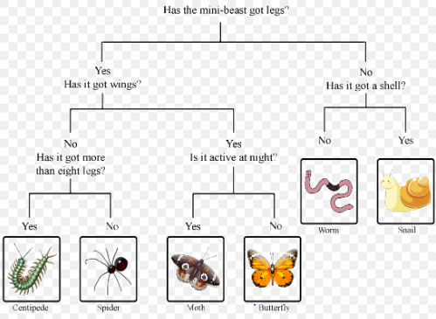
My Know And Remember More card about – Living Things and Their Habitats
Key facts to remember
1. Living things can be grouped (classified) in different ways according to their features.
2. Classification keys can be used to identify and name living things.
3. Habitats may change naturally e.g. through flooding, fire, earthquakes etc.
4. Humans also cause the environment to change. This can be in a good way (i.e. positive human impact, such as setting up nature reserves) or in a bad way (i.e. negative human impact, such as littering).
5. Environments also change with the seasons; different living things can be found in a habitat at different times of the year.
Vocabulary
Classification | putting things into groups.
Environment | everything living and everything nonliving.
Habitat | the particular environment that a plant or animal lives in.
Migrate | the seasonal movement of animals from one habitat to another in search of food, better conditions, or reproductive needs.
Hibernate | a way animals conserve energy to survive adverse weather conditions or lack of food.
Working Scientifically
gathering, recording, classifying and presenting data in a variety of ways to help in answering questions. recording findings using simple scientific language, drawings, labelled diagrams, keys, bar charts, and tables.
My memory jogger…
Prior Learning… | Future Learning…
Identify and name a variety of common wild and garden plants, including deciduous and evergreen trees. (Y1 - Plants) Identify and describe the basic structure of a variety of common flowering plants, including trees. (Y1 - Plants) Identify and name a variety of common animals including fish, amphibians, reptiles, birds and mammals. (Y1 - Animals including humans) Describe and compare the structure of a variety of common animals (fish, amphibians, reptiles, birds and mammals, including pets). (Y1 – Animals, including humans) Identify and name a variety of plants and animals in their habitats, including microhabitats. (Y2 - Living things and their habitats) | Describe the differences in the life cycles of a mammal, an amphibian, an insect and a bird. (Y5 - Living things and their habitats) Describe the life process of reproduction in some plants and animals. (Y5 - Living things and their habitats) Describe how living things are classified into broad groups according to common observable characteristics and based on similarities and differences, including microorganisms, plants and animals. (Y6 - Living things and their habitats) Give reasons for classifying plants and animals based on specific characteristics. (Y6 - Living things and their habitats)

