Slide 1

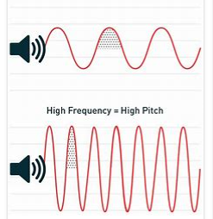
My Know And Remember More card about - Sound
Key facts to remember
1. A sound produces vibrations which travel through a medium from the source to our ears.
2. Different mediums such as solids, liquids and gases can carry sound, but sound cannot travel through a vacuum (an area empty of matter).
3. The vibrations cause parts of our body inside our ears to vibrate, allowing us to hear (sense) the sound.
4. The loudness (volume) of the sound depends on the strength (size) of vibrations which decreases as they travel through the medium.
5. A sound insulator is a material which blocks sound effectively.
Vocabulary
Vibration | A quick movement backwards and forwards.
Pitch | High or low sound.
Volume | How loud or quiet a sound is.
Insulation | a kind of measure to prevent the sound waves from permeating.
Sound | created when something vibrates and sends waves of energy (vibration) into our ears.
Source | Something that produces vibrations which travel through a medium.
Working Scientifically
setting up simple practical enquiries, comparative and fair tests. making systematic and careful observations and, where appropriate, taking accurate measurements using standard units.
My memory jogger…
Prior Learning… | Future Learning…
Explore how things work. (Nursery – Sound) Describe what they see, hear and feel whilst outside. (Reception – Sound) Identify, name, draw and label the basic parts of the human body and say which part of the body is associated with each sense. (Y1 - Animals, including humans) | Waves on water as undulations which travel through water with transverse motion; these waves can be reflected, and add or cancel – superposition. (KS3) Frequencies of sound waves, measured in Hertz (Hz); echoes, reflection and absorption of sound. (KS3) Sound needs a medium to travel, the speed of sound in air, in water, in solids. (KS3) Sound produced by vibrations of objects, in loud speakers, detected by their effects on microphone diaphragm and the ear drum; sound waves are longitudinal. (KS3) Auditory range of humans and animals. (KS3) Pressure waves transferring energy; use for cleaning and physiotherapy by ultra-sound. (KS3) Waves transferring information for conversion to electrical signals by microphone. (KS3)

