Slide 1

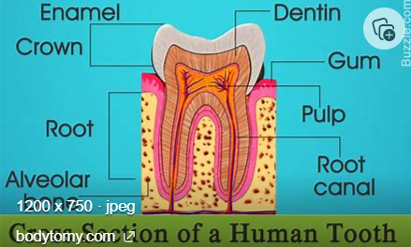
My Know And Remember More card about - Animals Including Humans.
Key facts to remember
1. Digestion starts when teeth start to break the food down.
2. Food passes from the mouth to the stomach via the oesophagus.
3. Food is broken down in the stomach where other chemicals are added.
4. Food passes into the small intestine where nutrients are removed from the food and leave the digestive system to be used elsewhere in the body.
5. The four types of teeth are : incisors for cutting, canines for tearing and molars and premolars for chewing .
Vocabulary
Digestion | how the body breaks down food so it can be taken in and used.
Saliva | a liquid in the mouth that contains enzymes that begin digestion.
Oesophagus | a tube that takes food from the mouth to the stomach.
Producer | a living thing that produces its own food, rather than consuming another living thing.
Consumer | a living thing that consumes (eats) another living thing for food, in order to get energy.
Working Scientifically
identifying differences, similarities or changes related to simple scientific ideas and processes. asking relevant questions and using different types of scientific enquiries to answer them.
My memory jogger…
Prior Learning… | Future Learning…
Identify and name a variety of common animals that are carnivores, herbivores and omnivores. (Y1 - Animals, including humans) Find out about and describe the basic needs of animals (Y2 - Animals, including humans) Describe the importance for humans of exercise, eating the right amounts of different types of food, and hygiene. (Y2 - Animals, including humans) Identify that animals, including humans, need the right types and amount of nutrition, and that they cannot make their own food; they get nutrition from what they eat. (Y3 - Animals, including humans) | Identify and name the main parts of the human circulatory system, and describe the functions of the heart, blood vessels and blood. (Y6 - Animals, including humans) Recognise the impact of diet, exercise, drugs and lifestyle on the way their bodies function. (Y6 - Animals, including humans) Describe the ways in which nutrients and water are transported within animals, including humans. (Y6 - Animals, including humans)

