Slide 1

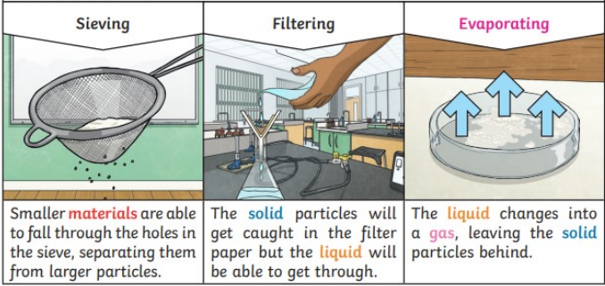
My Know And Remember More card about Properties of Materials
Key facts to remember
1. Materials have different uses depending on their properties and state (liquid, solid, gas).
2. Properties include hardness, transparency, electrical and thermal conductivity and attraction to magnets.
3. Some materials will dissolve in a liquid and form a solution while others are insoluble and form sediment.
4. Mixtures can be separated by filtering, sieving and evaporation.
5. Some changes to materials such as dissolving, mixing and changes of state are reversible, but some changes such as burning wood, rusting and mixing vinegar with bicarbonate of soda result in the formation of new materials and these are not reversible.
Vocabulary
Insulator | a substance which does not readily allow the passage of heat or sound.
Conductor | a material or device that conducts or transmits heat or electricity, especially when regarded in terms of its capacity to do this.
Soluble | able to be dissolved, especially in water.
Insoluble | incapable of being dissolved.
Reversible | able to be turned the other way round.
Irreversible | not able to be undone or altered.
Working Scientifically
planning different types of scientific enquiries to answer questions, including recognising and controlling variables where necessary. using test results to make predictions to set up further comparative and fair tests.
Diagram of…
Prior Learning… | Future Learning…
Identify and compare the suitability of a variety of everyday materials. (Y2 - Uses of everyday materials) Find out how the shapes of solid objects made from some materials can be changed. (Y2 - Uses of everyday materials) Compare and group together a variety of everyday materials.(Y3 - Forces and magnets) Compare and group materials together, according to whether they are solids, liquids or gases. (Y4 - States of matter) Observe that some materials change state when they are heated or cooled, and measure or research the temperature at which this happens in degrees Celsius (°C). (Y4 - States of matter) Identify the part played by evaporation and condensation in the water cycle and associate the rate of evaporation with temperature. (Y4 - States of matter) | Chemical reactions as the rearrangement of atoms. (KS3) Representing chemical reactions using formulae and using equations. (KS3) Combustion, thermal decomposition, oxidation and displacement reactions. (KS3) Defining acids and alkalis in terms of neutralisation reactions. (KS3) The pH scale for measuring acidity/alkalinity; and indicators. (KS3)

