Slide 1

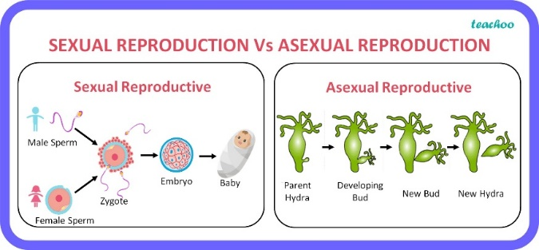
My Know And Remember More card about Living Things and Their Habitats
Key facts to remember
1. As part of their life cycle, plants and animals reproduce.
2. Most animals reproduce sexually. This involves two parents where the sperm from the male fertilises the female egg.
3. Animals, including humans, have offspring which grow into adults.
4. Plants reproduce both sexually and asexually.
5. Sexual reproduction occurs through pollination, usually involving wind or insects.
Vocabulary
Metamorphosis | the process of transformation from an immature form to an adult form in two or more distinct stages.
Sexual reproduction | the production of new living organisms by combining genetic information from two individuals of different types (sexes).
Asexual reproduction | Asexual reproduction is a type of reproduction that does not involve the fusion of gametes or change in the number of chromosomes.
Life cycle | the series of changes in the life of an organism including reproduction.
Fertilizes | cause (an egg, female animal, or plant) to develop a new individual by introducing male reproductive material.
Working Scientifically
identifying scientific evidence that has been used to support or refute ideas or arguments. reporting and presenting findings from enquiries, including conclusions, causal relationships and explanations of and degree of trust in results, in oral and written forms such as displays and other presentations.
My memory jogger…
Prior Learning… | Future Learning…
Notice that animals, including humans, have offspring which grow into adults. (Y2 - Animals, including humans) Explore the part that flowers play in the life cycle of flowering plants, including pollination, seed formation and seed dispersal. (Y3 - Plants) | Reproduction in humans (as an example of a mammal), including the structure and function of the male and female reproductive systems, menstrual cycle (without details of hormones), gametes, fertilisation, gestation and birth, to include the effect of maternal lifestyle on the foetus through the placenta. (KS3) Reproduction in plants, including flower structure, wind and insect pollination, fertilisation, seed and fruit formation and dispersal, including quantitative investigation of some dispersal mechanisms. (KS3)

