Slide 1

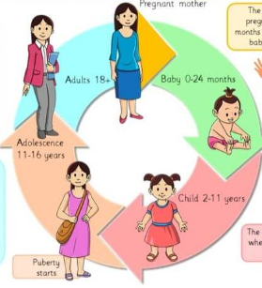
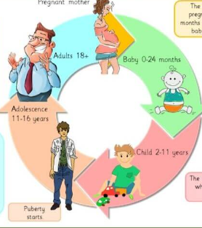
My Know And Remember More card about Living Things and Their Habitats
Key facts to remember
1. When babies are young, they grow rapidly.
2. As babies develop, they learn many skills.
3. At puberty, a child’s body changes and develops primary and secondary sexual characteristics.
4. Babies and children are dependent on their parents.
5. Changes are needed to be made at old age to ensure a healthy lifestyle continues.
Vocabulary
Puberty | the period during which adolescents reach sexual maturity and become capable of reproduction.
Reproduce | produce offspring by a sexual or asexual process.
Adolescence | the period following the onset of puberty during which a young person develops from a child into an adult.
Gestation | the process or period of developing inside the womb between conception and birth.
Working Scientifically
recording data and results of increasing complexity using scientific diagrams and labels, classification keys, tables, scatter graphs, bar and line graphs. identifying scientific evidence that has been used to support or refute ideas or arguments.
Diagram of…
Prior Learning… | Future Learning…
Notice that animals, including humans, have offspring which grow into adults. (Y2 - Animals, including humans) | Reproduction in humans (as an example of a mammal), including the structure and function of the male and female reproductive systems, menstrual cycle (without details of hormones), gametes, fertilisation, gestation and birth, to include the effect of maternal lifestyle on the foetus through the placenta. (KS3)

