Slide 1

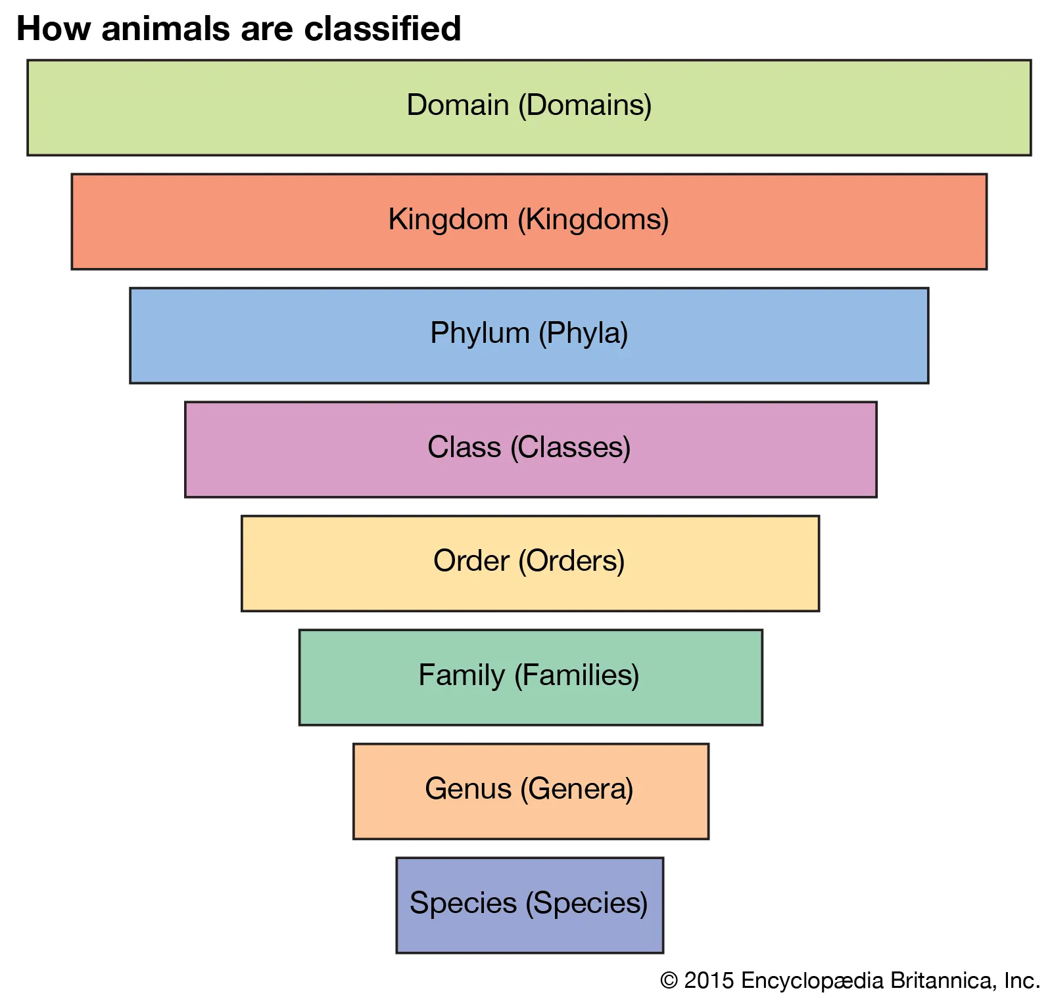
My Know And Remember More card about - Living Things and Their Habitats
Key facts to remember
1. Living things can be formally grouped according to characteristics
2. Plants and animals are two main groups but there are other livings things that do not fit into these groups e.g. micro-organisms such as bacteria and yeast, and toadstools and mushrooms.
3. Animals can be divided into two main groups: those that have backbones (vertebrates); and those that do not (invertebrates).
4. Vertebrates can be divided into five small groups: fish; amphibians; reptiles; birds; and mammals. Each group has common characteristics.
5. Invertebrates can be divided into a number of groups, including insects, spiders, snails and worms.
Vocabulary
Vertebrates | an animal of a large group distinguished by the possession of a backbone or spinal column.
Invertebrates | an animal lacking a backbone.
Flowering | the action of producing flowers.
Non-flowering | producing no flowers.
Working Scientifically
recording data and results of increasing complexity using scientific diagrams and labels, classification keys, tables, scatter graphs, bar and line graphs. planning different types of scientific enquiries to answer questions, including recognising and controlling variables where necessary.
My memory jogger…
Prior Learning… | Future Learning…
Recognise that living things can be grouped in a variety of ways. (Y4 - Living things and their habitats) Explore and use classification keys to help group, identify and name a variety of living things in their local and wider environment. (Y4 - Living things and their habitats) Describe the differences in the life cycles of a mammal, an amphibian, an insect and a bird. (Y5 - Living things and their habitats) Describe the life process of reproduction in some plants and animals. (Y5 - Living things and their habitats) | Differences between species. (KS3)

