Slide 1

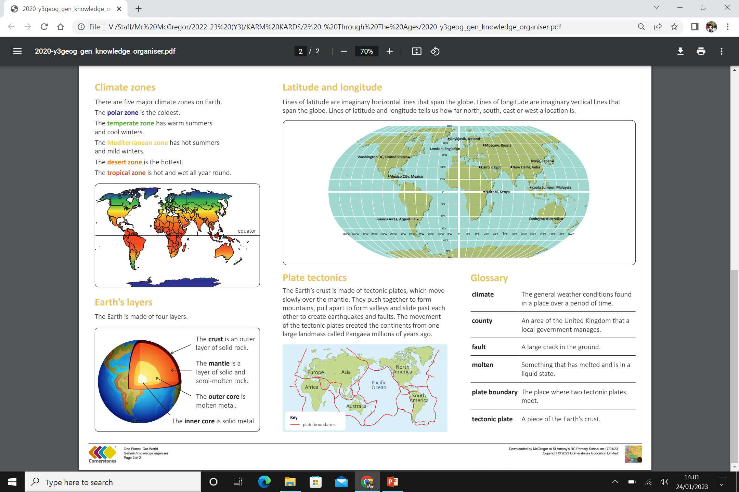
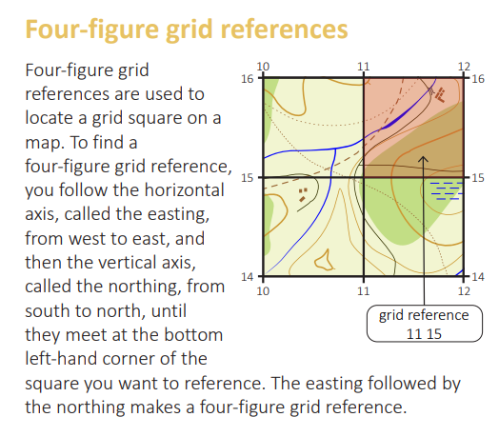
My Know And Remember More card about Through the Ages
Key facts to remember
The countries of England, Northern Ireland, Scotland and Wales are divided into counties. Counties in the United Kingdom include Yorkshire, Suffolk, Pembrokeshire, Inverness-shire and County Armagh.
The Earth’s crust is made of tectonic plates, which move slowly over the mantle. They push together to form mountains, pull apart to form valleys and slide past each other to create earthquakes and faults.
Lines of latitude are imaginary horizontal lines that span the globe. Lines of longitude are imaginary vertical lines that span the globe. Lines of latitude and longitude tells us how far north, south, east or west a location is.
There are eight points on a compass. There are four cardinal points: north, south, east and west.
There are four intercardinal points of a compass are: north-east, north-west, south-east and south-west.
Vocabulary
climate | The general weather conditions found in a place over a period of time.
County | An area of the United Kingdom that a local government manages.
fault | A large crack in the ground.
molten | Something that has melted and is in a liquid state.
plate boundary | The place where two tectonic plates meet.
tectonic plate | A piece of the Earth’s crust.
agriculture
My memory jogger
Diagram of…
This links to… | What’s next?
Science History

