Slide 1

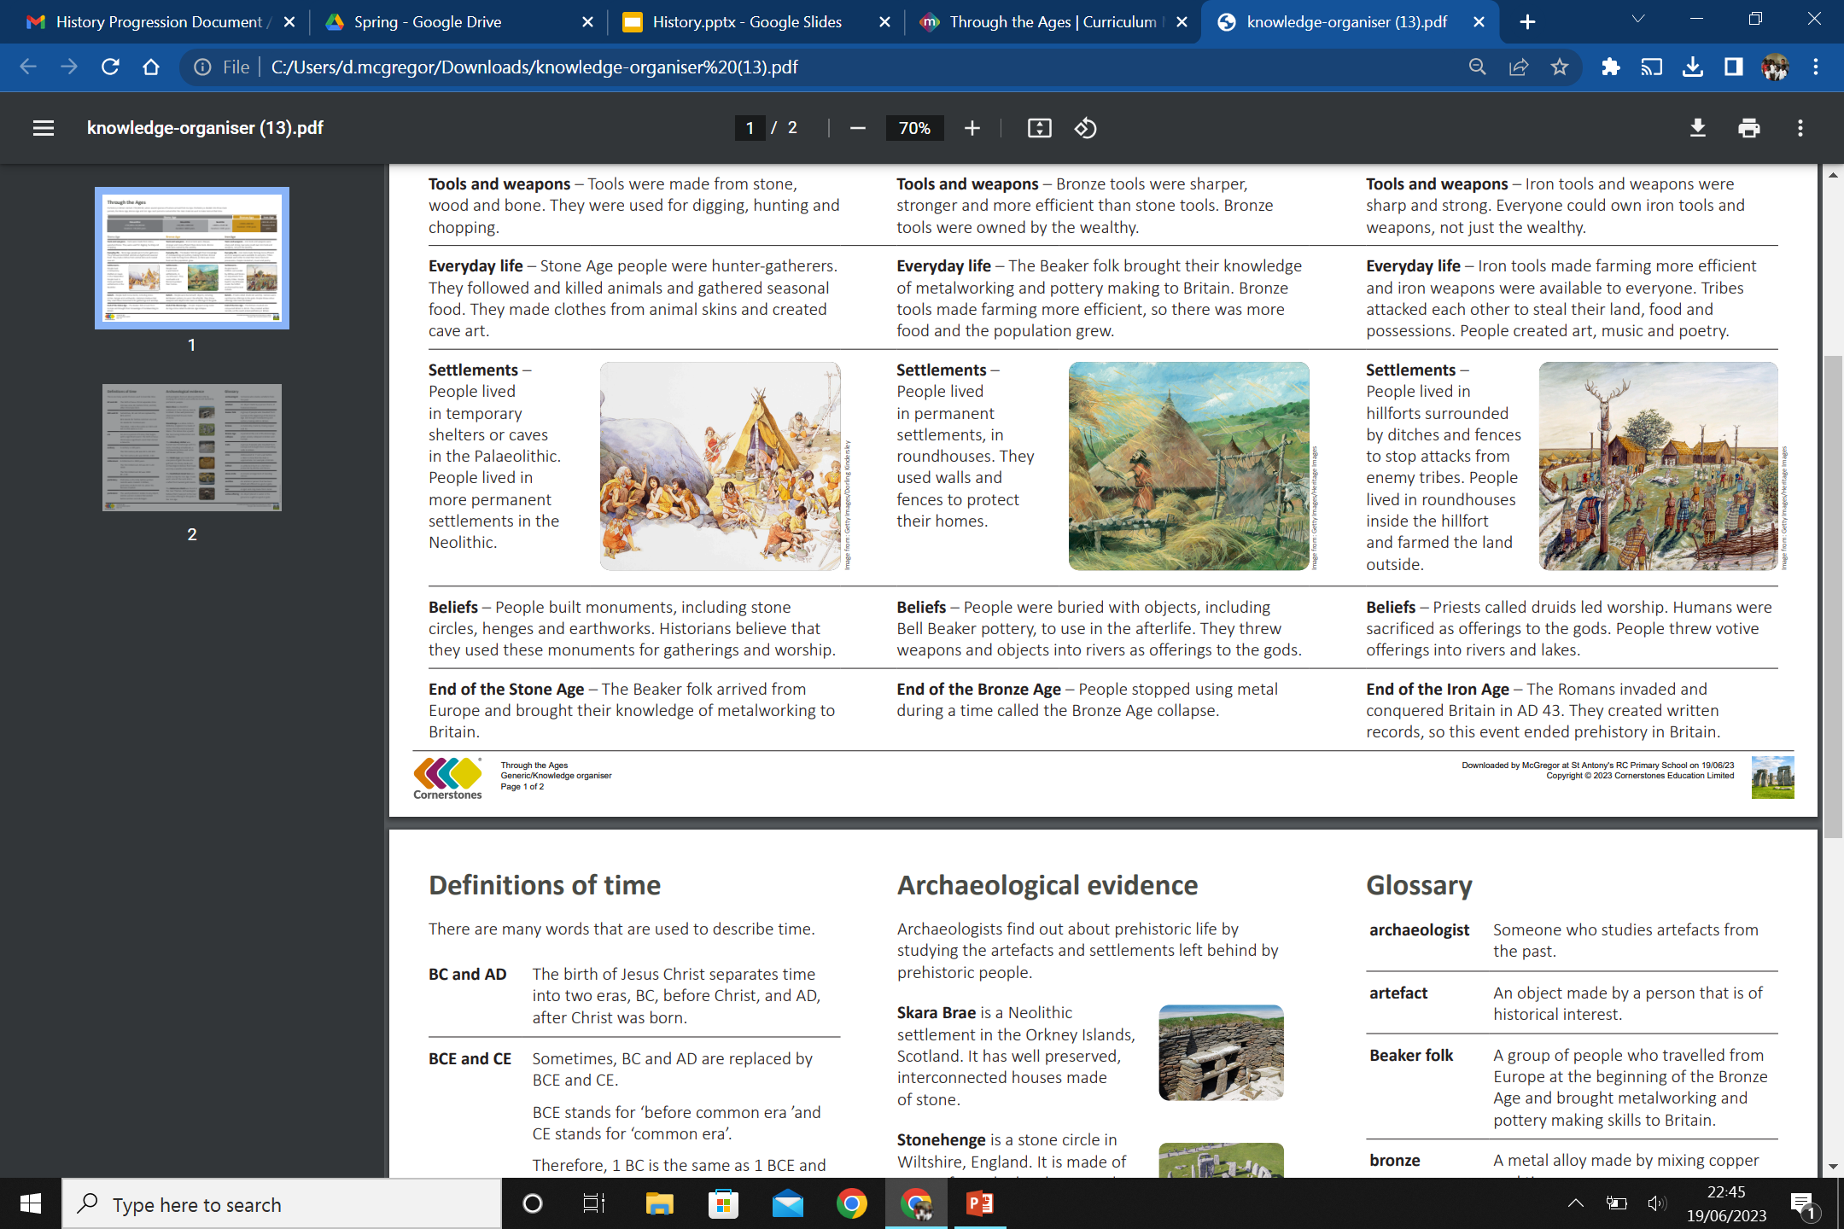
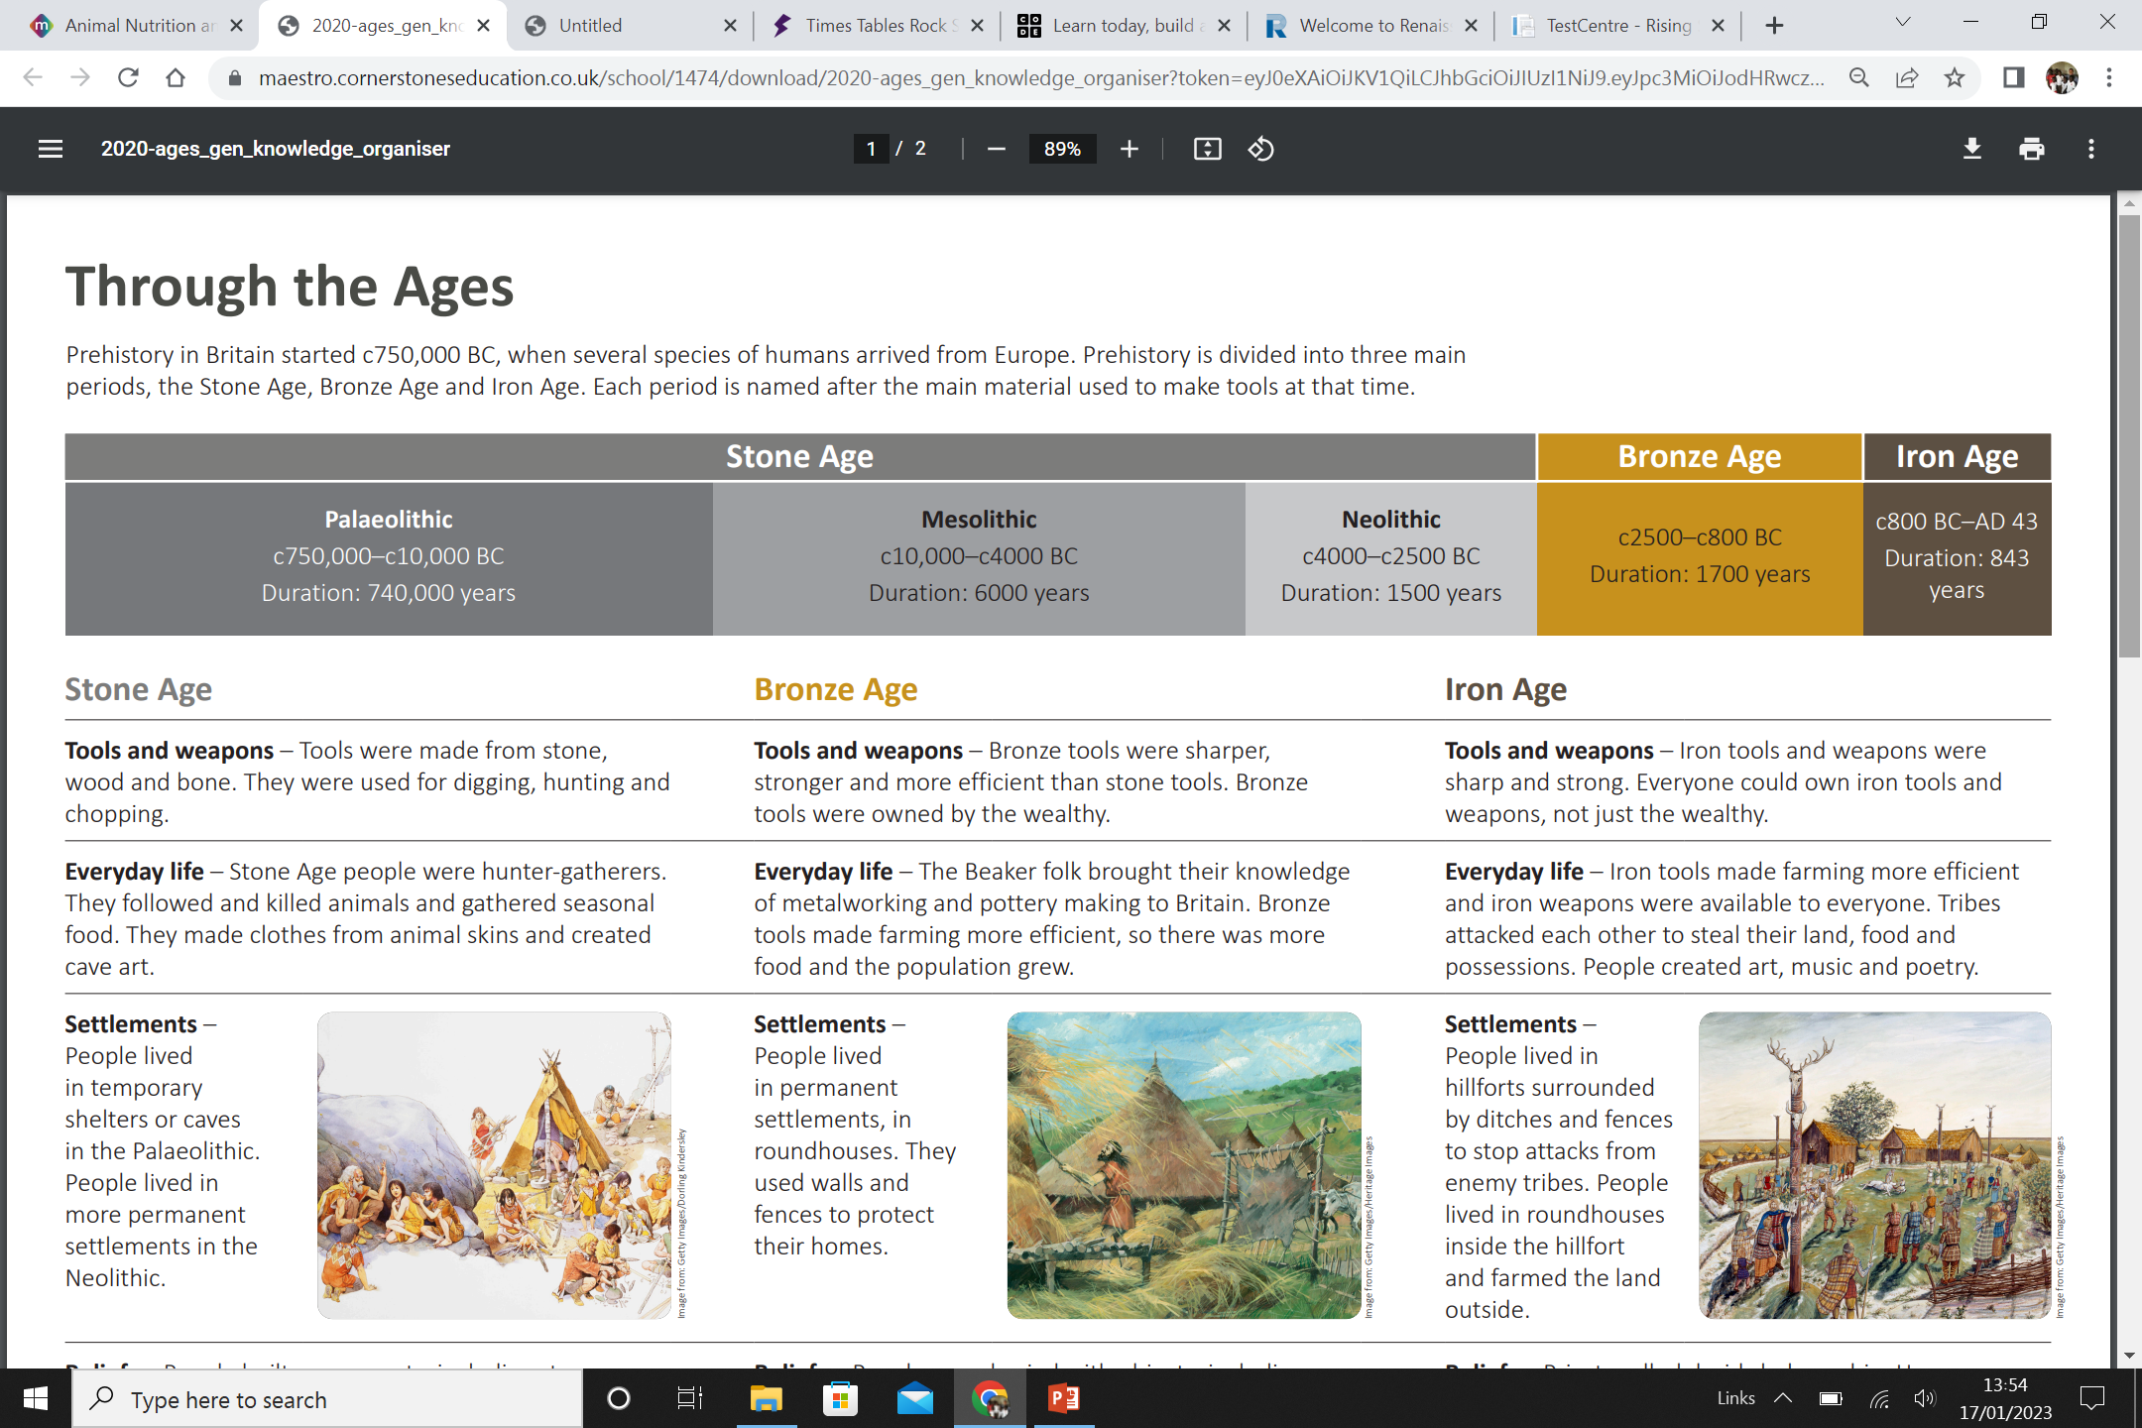
My Know And Remember More card: ‘Through The Ages’
Key facts to remember
The birth of Jesus Christ separates time into two eras, BC, before Christ, and AD, after Christ was born.
Stone Age – Tools were made from stone, wood and bone. They were used for digging, hunting and chopping.
Bronze Age – Bronze tools were sharper, stronger and more efficient than stone tools. Bronze tools were owned by the wealthy.
Iron Age – Iron tools and weapons were sharp and strong. Everyone could own iron tools and weapons, not just the wealthy.
Skara Brae is a Neolithic settlement in the Orkney Islands, Scotland. It has well preserved, connected houses made of stone.
Vocabulary
Artefect | An object made by a person that is of historical interest.
archaeologist | Someone who studies artefacts from the past.
Era | An era is a period of history that begins with a significant event. The birth of Jesus Christ was a significant event that started a new era.
Prehistory | Prehistory is the time before written records were created. In Britain, prehistory ended in AD 43, when the Romans invaded.
Prehistoric | The word prehistoric relates to any object, animal, person or place that existed before written records began.
Millenium | 1000 years
My memory jogger
Diagram of… Ages Timeline
This links to… | What’s next?
Science – Skeletal System Geography – Our Planet, Our World

