Slide 1

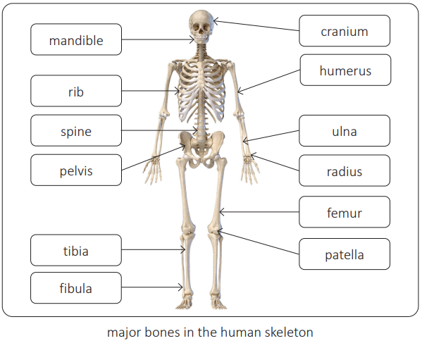
My Know And Remember More card about - Animals Including Humans
Key facts to remember
1. Animals, unlike plants which can make their own food, need to eat in order to get the nutrients they need.
2. Food contains a range of different nutrients – carbohydrates (including sugars), protein, vitamins, minerals, fats, sugars, water – and fibre that are needed by the body to stay healthy.
3. A piece of food will often provide a range of nutrients.
4. Humans, and some other animals, have skeletons and muscles which help them move and provide protection and support.
Vocabulary
Nutrition | the process of taking in food and converting it into energy and other vital nutrients required for life.
Skeleton | the internal framework of the human body.
Muscle | a body tissue composed of sheets or bundles of cells that contract to produce movement or increase tension.
Joints | the part of the body where two or more bones meet to allow movement.
Working Scientifically
classifying and presenting data in a variety of ways. recording findings using simple scientific language, drawings, labelled diagrams, keys, bar charts, and tables.
My memory jogger…
Prior Learning… | Future Learning…
Identify and name a variety of common animals including fish, amphibians, reptiles, birds and mammals. (Y1 - Animals, including humans) Identify and name a variety of common animals that are carnivores, herbivores and omnivores. (Y1 - Animals, including humans) Describe and compare the structure of a variety of common animals (fish, amphibians, reptiles, birds and mammals, including pets). (Y1 - Animals, including humans) Find out about and describe the basic needs of animals, including humans, for survival (water, food and air). (Y2 - Animals, including humans) Describe the importance for humans of exercise, eating the right amounts of different types of food, and hygiene. (Y2 - Animals, including humans) | Describe the simple functions of the basic parts of the digestive system in humans. (Y4 - Animals, including humans) Identify the different types of teeth in humans and their simple functions. (Y4 - Animals, including humans) Construct and interpret a variety of food chains, identifying producers, predators and prey. (Y4 - Animals, including humans) Recognise the impact of diet, exercise, drugs and lifestyle on the way their bodies function. (Y6 - Animals, including humans)

