Slide 1

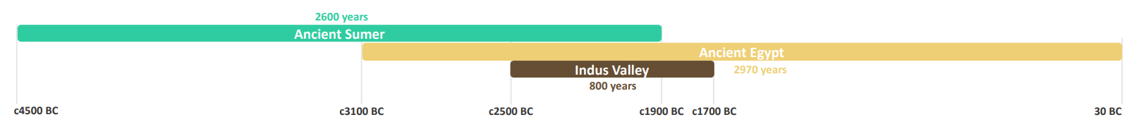
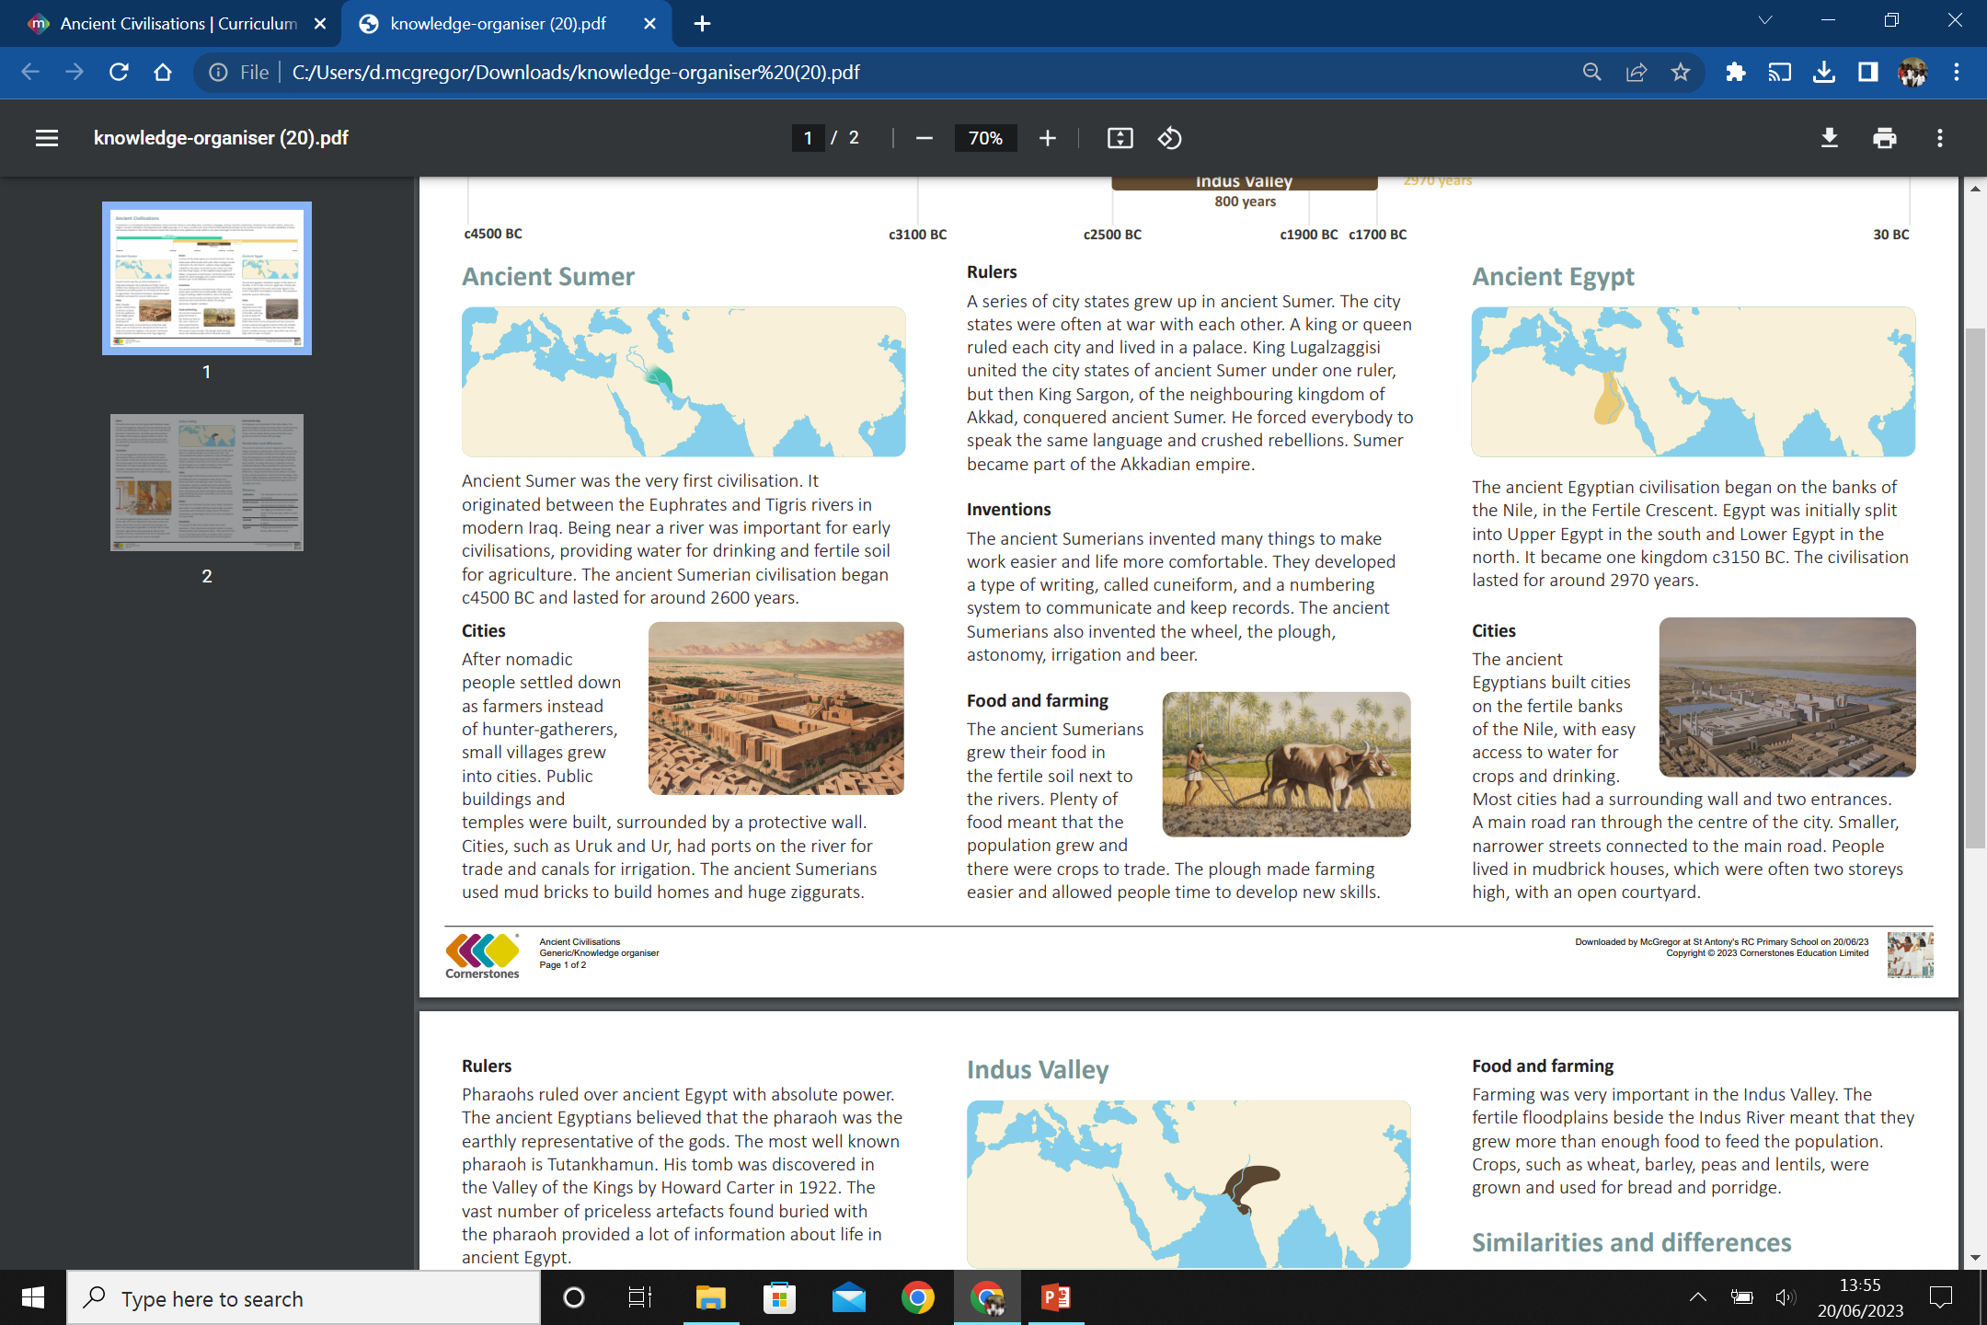
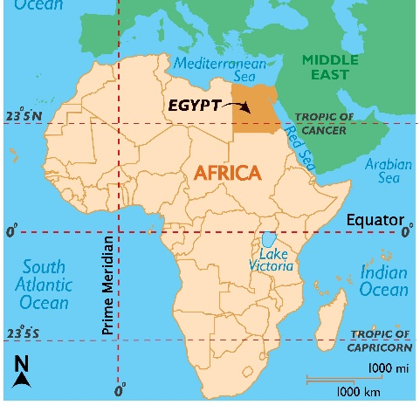
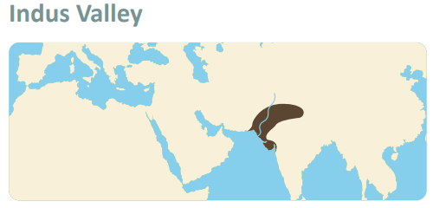
My Know And Remember More card about Ancient Civilisations
Key facts to remember
Cairo is the capital city of Egypt.
The Nile is the longest river in the world (6,650 km in distance).
Without the Nile River, all of Egypt would be desert. Only about an inch (2.5 centimeters) of rain falls throughout Egypt each year.
Egypt is a transcontinental country – meaning its actually sits across two continents – Africa and Asia.
Most people in ancient Egypt were farmers. They lived with their families in houses made of mud bricks that were near the Nile River because the land was so fertile.
Vocabulary
Fertile Crescent | The semicircular area of land where the first ancient civilisations began.
Civilisation | The developed culture and way of life of a society.
Irrigation | The digging of channels to allow water to flow through a field to water crops.
Nomadic | A lifestyle involving moving from place to place.
Ziggurat | A large pyramid made from mud bricks, with a temple on top.
My memory jogger
Diagram of… an ancient Egyptian timeline.
This links to… | What’s next?
History – Ancient Civilisations

