Slide 1

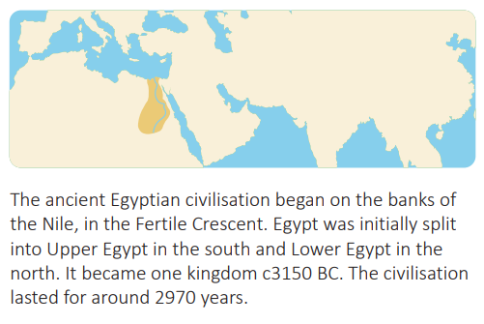

My Know And Remember More card: ‘Ancient Civilisations’
Key facts to remember
A civilisation is a developed society. Civilisations share common features, including cities, inventions, language, writing, hierarchy, leadership, infrastructure, arts and culture, trade and religion.
Pharaohs ruled over ancient Egypt with absolute power. The ancient Egyptians believed that the pharaoh was the earthly representative of the gods.
The most well known pharaoh is Tutankhamun. His tomb was discovered in the Valley of the Kings by Howard Carter in 1922.
There were three main ancient civilisations: Sumerians, Egyptians and Indus Valley.
The ancient Sumerians, ancient Egyptians and Indus Valley civilisation all developed next to rivers, which they used to provide water and transport. They all made good use of the fertile land for growing crops.
Vocabulary
Civilisation | The developed culture and way of life of a society.
Fertile Cresent | The semicircular area of land where the first ancient civilisations began.
Irrigation | The digging of channels to allow water to flow through a field to water crops.
Nomadic | A lifestyle involving moving from place to place.
Ziggurat | A large pyramid made from mud bricks, with a temple on top.
My memory jogger
Diagram of… Ancient Egyptian Timeline
This links to… | What’s next?

