Slide 1

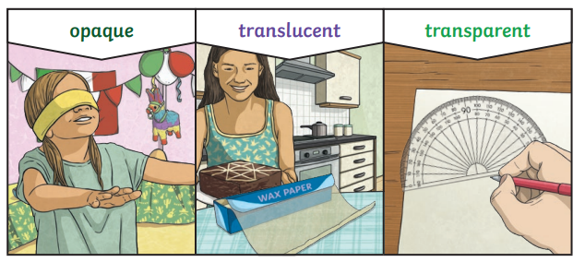
My Know And Remember More card about - Light
Key facts to remember
1. We see objects because our eyes can sense light.
2. Dark is the absence of light. We cannot see anything in complete darkness.
3. Some objects, for example, the sun, light bulbs and candles are sources of light.
4. Some surfaces reflect light.
5. Shadows are formed on a surface when an opaque or translucent object is between a light source and the surface and blocks some of the light.
Vocabulary
Reflect | To bounce off.
Opaque | Something that does not let light through it.
Translucent | Something that lets some light through but the light scatters so we can’t see through it easily.
Transparent | Something that lets light pass through it easily – meaning that we can see through it.
Shadow | The area of darkness where light has been blocked.
Working Scientifically
setting up simple practical enquiries, comparative and fair tests. reporting on findings from enquiries, including oral and written explanations, displays or presentations of results and conclusions.
My memory jogger…
Prior Learning… | Future Learning…
Explore how things work. (Nursery – Light) Talk about the differences in materials and changes they notice. (Nursery – Light) Describe what they see, hear and feel whilst outside. (Reception – Light) Identify, name, draw and label the basic parts of the human body and say which part of the body is associated with each sense. (Y1 - Animals, including humans) Describe the simple physical properties of a variety of everyday materials. (Y1 - Materials) | Recognise that light appears to travel in straight lines. (Y6 - Light) Use the idea that light travels in straight lines to explain that objects are seen because they give out or reflect light into the eye. (Y6 - Light) Explain that we see things because light travels from light sources to our eyes or from light sources to objects and then to our eyes. (Y6 - Light) Use the idea that light travels in straight lines to explain why shadows have the same shape as the objects that cast them. (Y6 - Light)

