Slide 1

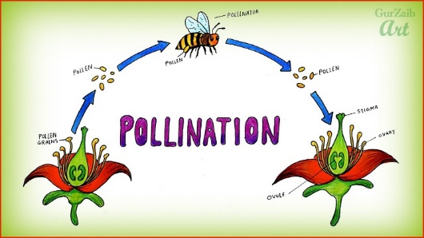
My Know And Remember More card about - Plants
Key facts to remember
1. Many plants, but not all, have roots, stems/trunks, leaves and flowers/blossom
2. Some plants produce flowers which enable the plant to reproduce.
3. Pollen, which is produced by the male part of the flower, is transferred to the female part of other flowers (pollination).
4. Different plants require different conditions for germination and growth.
Vocabulary
Pollen | a fine powder produced by certain plants when they reproduce.
Photosynthesis | the process that plants go through to make food by using sunlight and chlorophyll to turn water and carbon dioxide into nutrients.
Seed dispersal | the means by which a plant ensures its seeds are spread as far as possible from the parent plant.
Seed formation | After the plant has been pollinated a new seed will start to develop inside the ovary.
Working Scientifically
setting up simple practical enquiries, comparative and fair tests. gathering, recording, classifying and presenting data in a variety of ways to help in answering questions.
My memory jogger…
Prior Learning… | Future Learning…
Observe and describe how seeds and bulbs grow into mature plants. (Y2 - Plants) Find out and describe how plants need water, light and a suitable temperature to grow and stay healthy. (Y2 - Plants) | Describe the life process of reproduction in some plants and animals. (Y5 - Living things and their habitats) Reproduction in plants, including flower structure, wind and insect pollination, fertilisation, seed and fruit formation and dispersal, including quantitative investigation of some dispersal mechanisms. (KS3)

