Slide 1

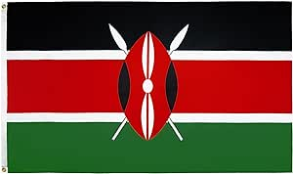
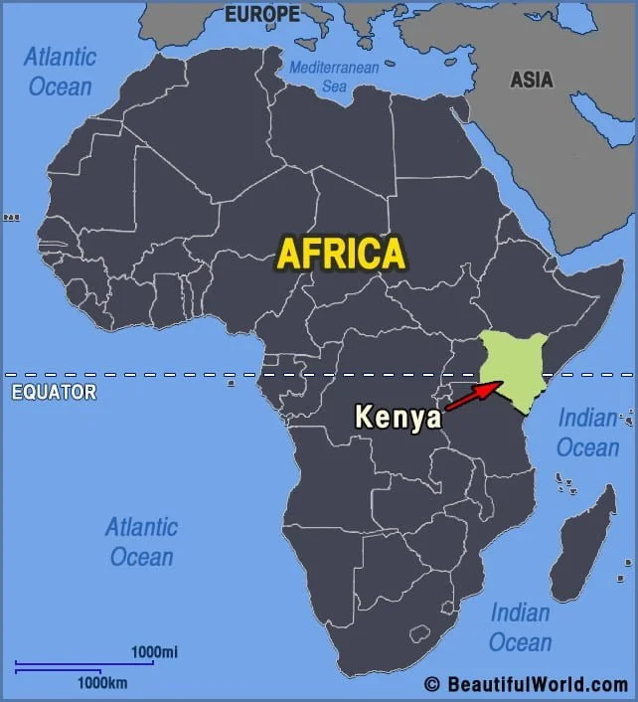

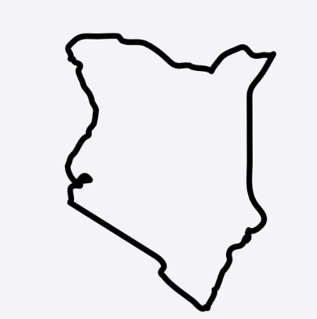

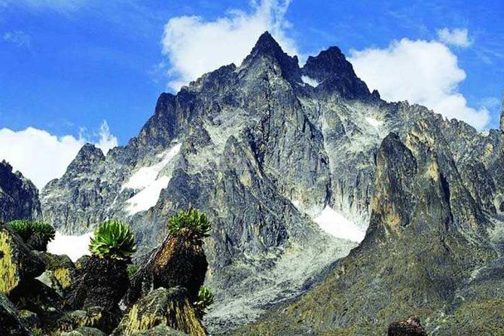
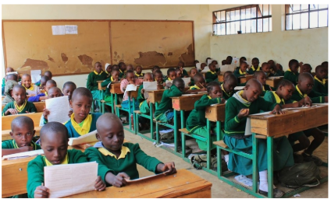
My Know And Remember More card about Geography- How different is Naro Moru to Blackburn?
Vocabulary
Nairobi | The capital city of Kenya.
Country Border | A border is a real or artificial line which separates countries (geographical boundaries)
Climate | weather of a specific region over a long period of time.
Rural | Areas that are not towns or cities. They are often farming areas.
Traditional | Something (a style or custom) that has been one for many years
Key facts to remember
1. Naro Moru is a small farming town in central Kenya in the continent of Africa
2. Kenya’s weather and seasons are very different to Blackburn due to its location on the equator.
3. Some physical features of Naro Moru are Mount Kenya and River Naro Moru River.
4. The houses in Naro Moru are more spread out and separated with fields.
5. Children go to school in Naro Moru but there day begins earlier.
My memory jogger
Previous learning | Future Learning
Building on Year 2’s previous unit “ Would you prefer to live in a hot or cold country?” I can recall and locate the continents of the world and identify weather patterns. | Physical Geography - In Y3, a study on volcanoes and earthquakes – Mount Kenya is an extinct Volcano. I will look at an in depth study of the continent, Europe in Y3 in the summer term.

