Slide 1

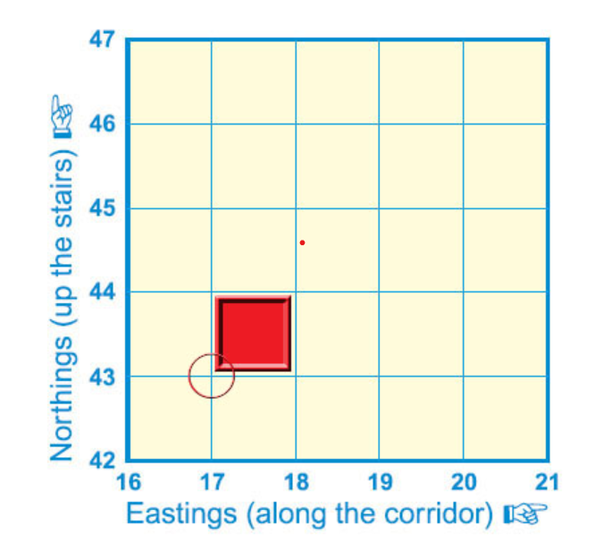
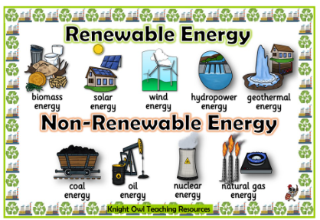
My Know And Remember More card …. Where does our energy come from?
Key facts to remember
1. Four-figure grid references are used to locate a particular grid square on a map.
2. There are two types of energy: renewable and non-renewable. Renewable energy includes solar power, wind power and hydropower. Non-renewable energy included oil and coal.
3. There are positives and drawbacks to using both renewable and non-renewable energy.
4. The UK has made significant efforts to diversify its energy sources. Renewable energy, such as wind, solar, and hydroelectric power, has become more prominent due to environmental concerns.
5. Consideration of the benefits and drawbacks of an energy source and its location are necessary when planning new energy source facilities.
Vocabulary
Eastings | Are the vertical lines running from the top to bottom and divide the map from west to east.
Northings | Are numbered horizontal lines found on maps. The equator is a northing line, and additional invisible lines surround the Earth moving away from the equator.
Hydropower | Energy that comes from moving water. Fast-flowing rivers, waterfalls and the waves at sea are used to spin turbines that generate electricity.
Sustainability | Is the idea that humans must interact with the environment in a way that ensures there will be enough resources left for future generations.
Environmental | Relating to or caused by the surroundings in which someone lives or something exists.
My memory jogger
Types of energy…
Previous learning | Future Learning…
I have an understanding of how land is used in the UK from my learning in Y3. | In Year 5 I will look Trade and how energy powers transport systems.

